Slide 1
Lecture 6: Backpropagation

Slide 2
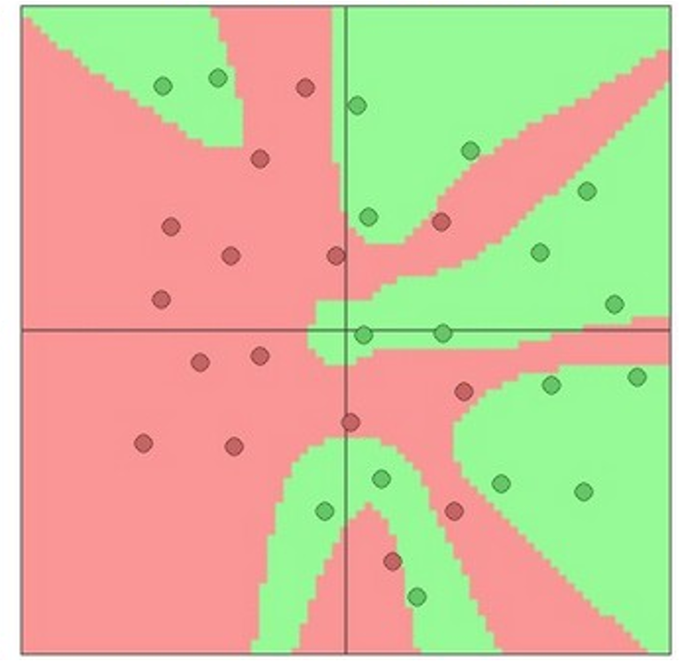

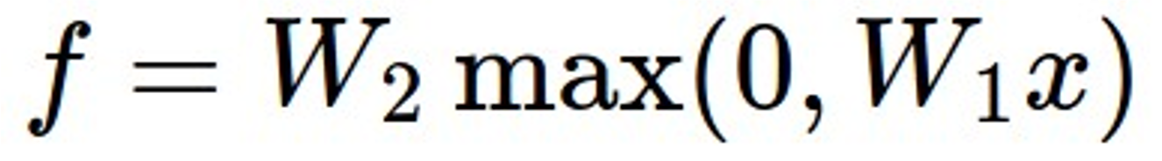
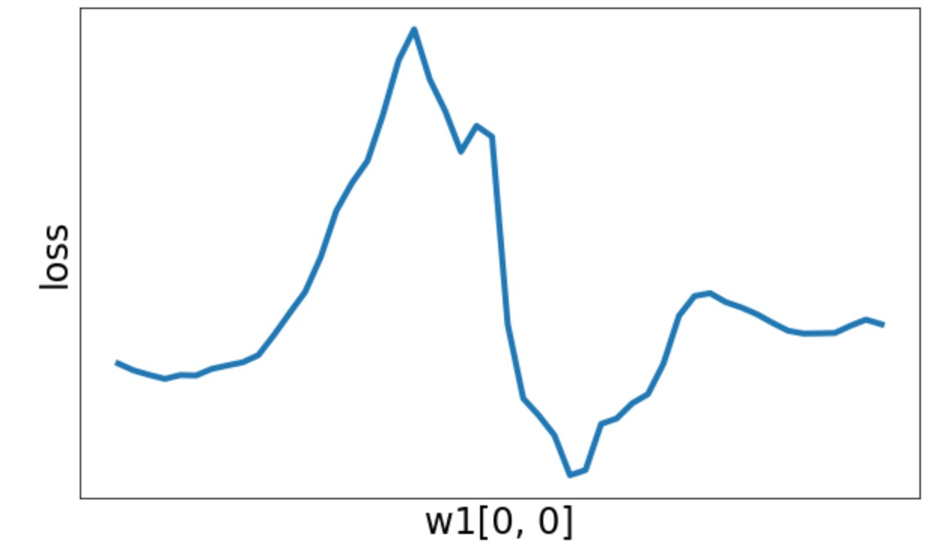
Last time: Neural Networks
Space Warping
From linear classifiers to fully-connected networks
Universal Approximation
x
h
Input: 3072
W₁
W₂
s
Nonconvex
Output: 10
Hidden layer: 100

Slide 3
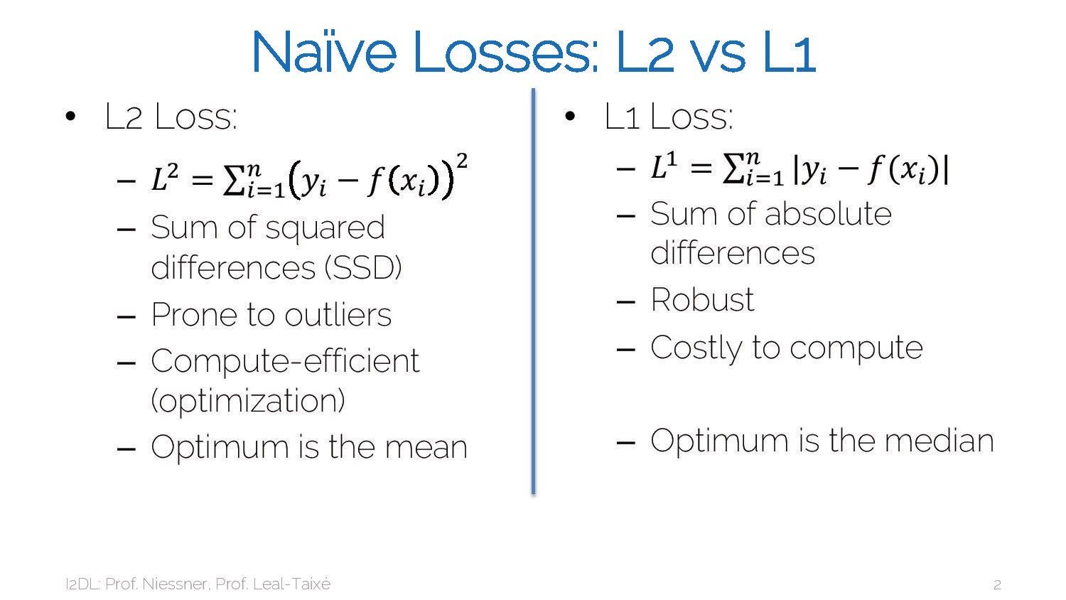
3

Slide 4
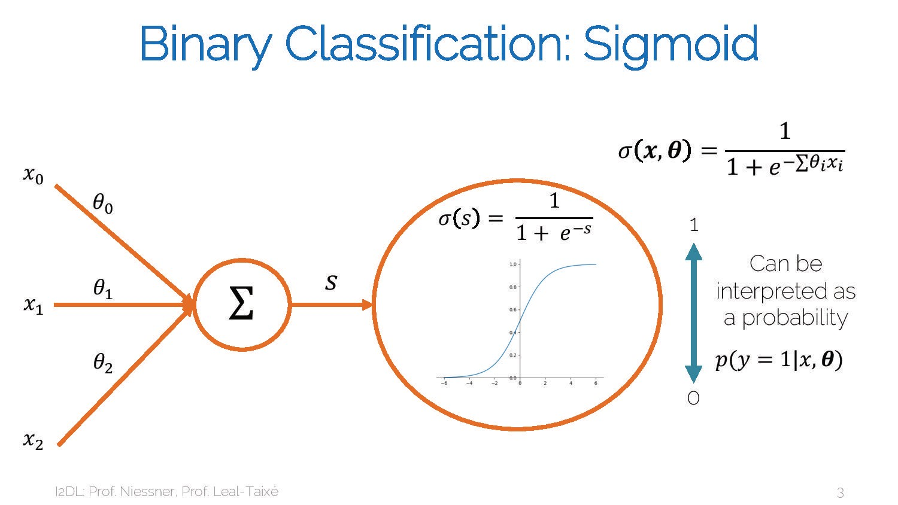
4

Slide 5
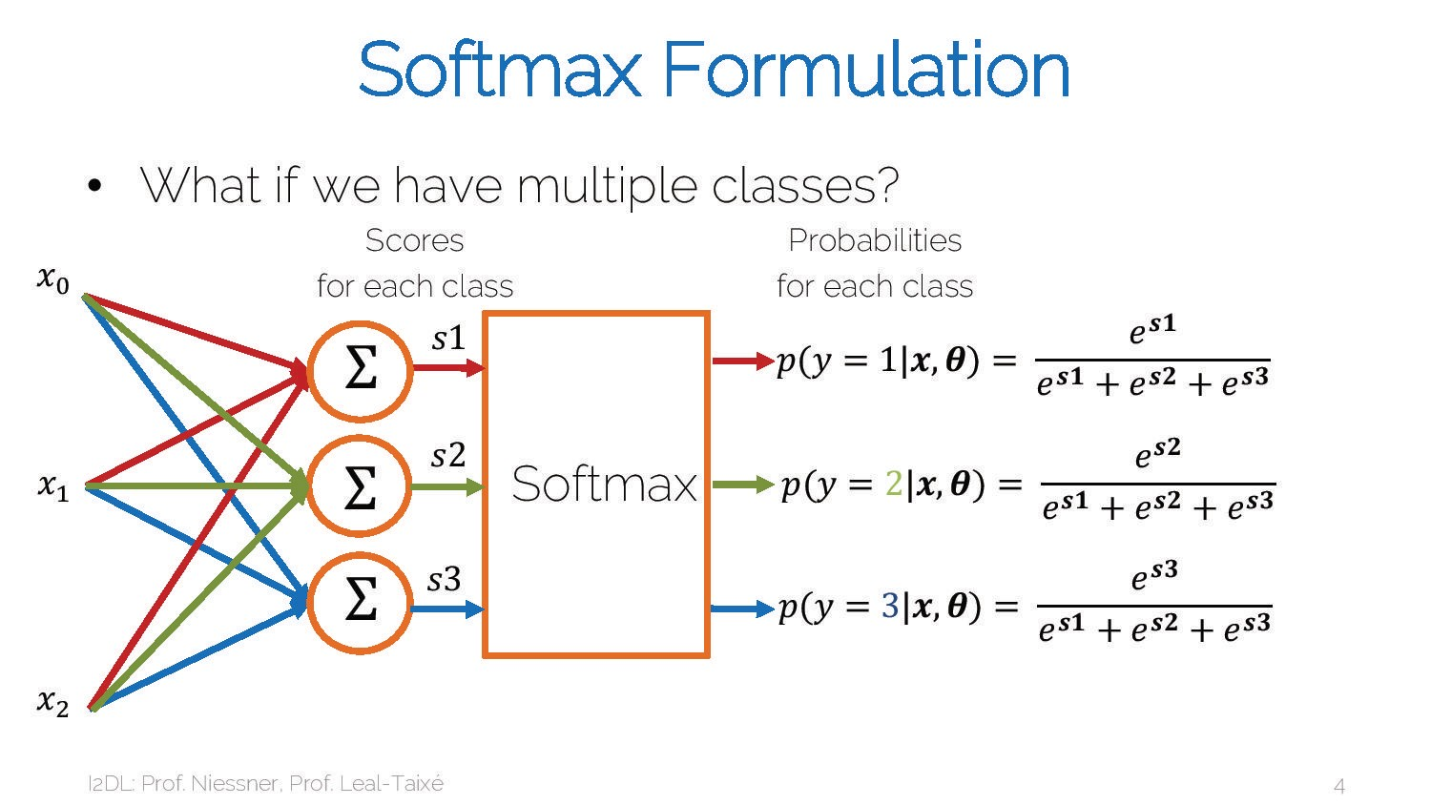
5

Slide 6
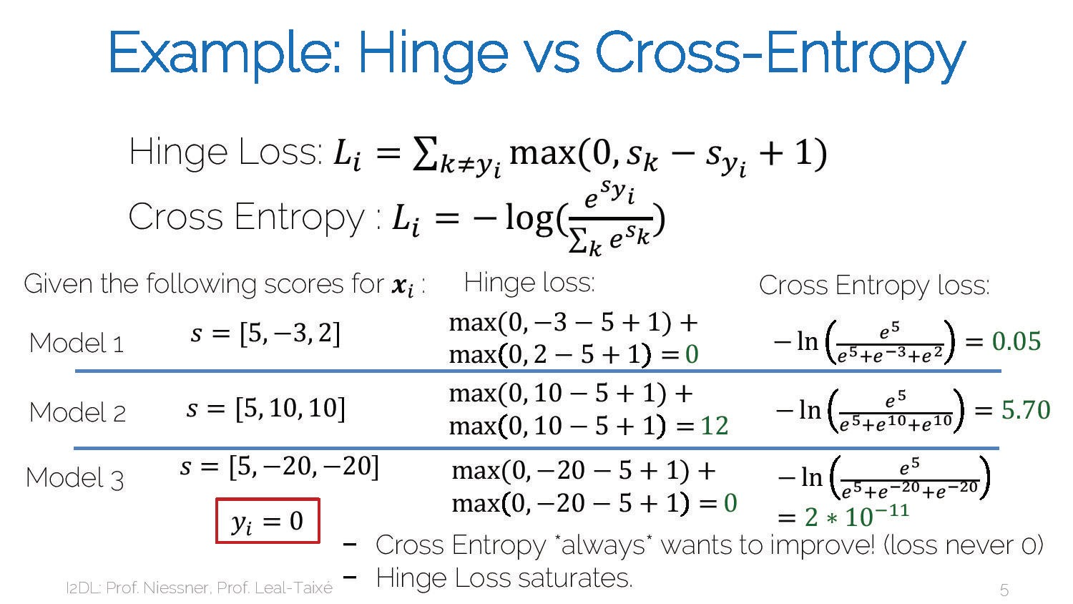
6

Slide 7
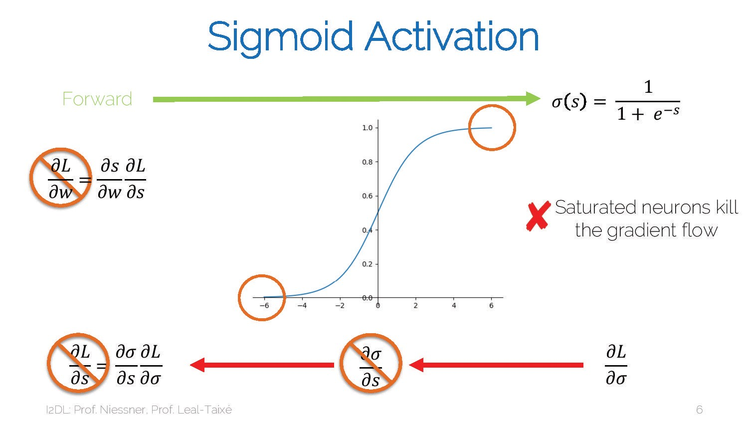
7

Slide 8
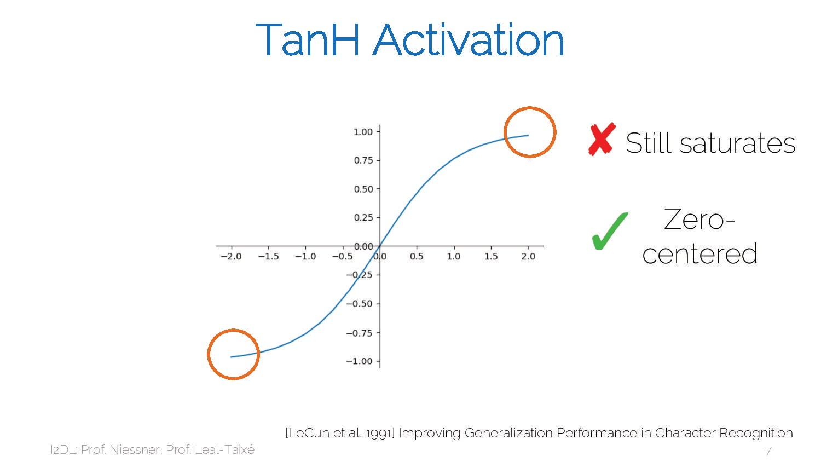
8

Slide 9
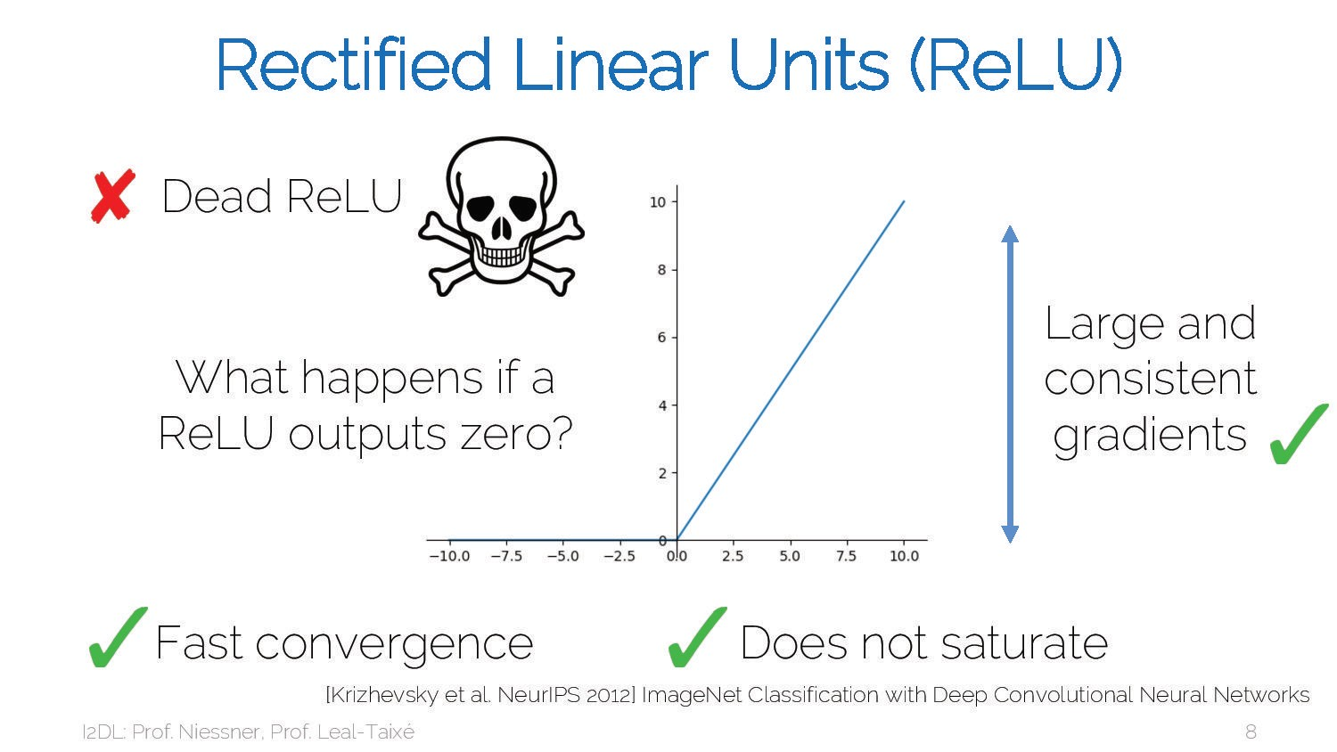
9

Slide 10
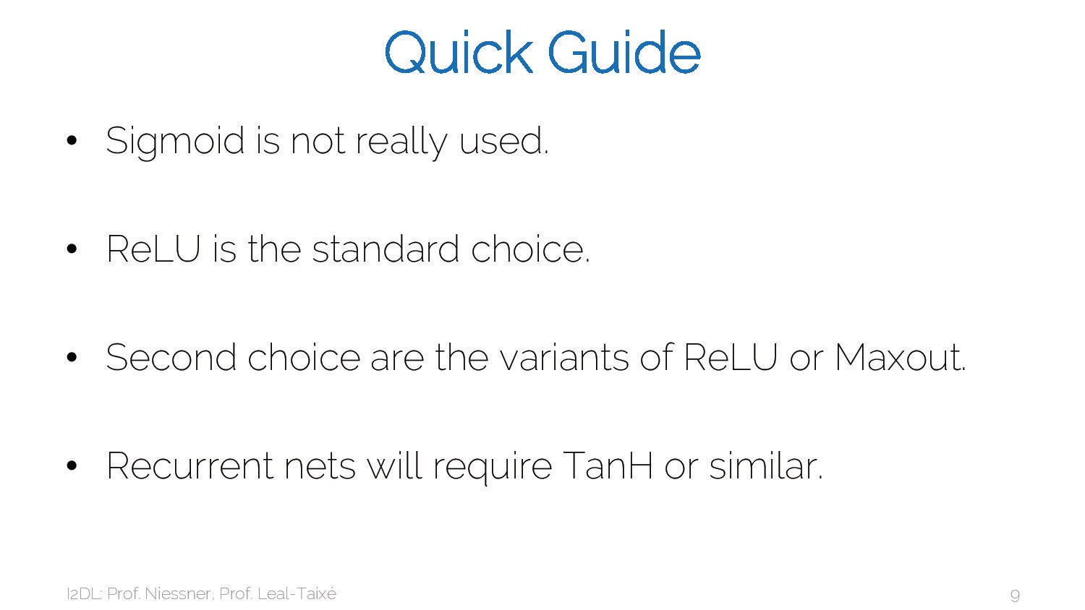
10

Slide 11
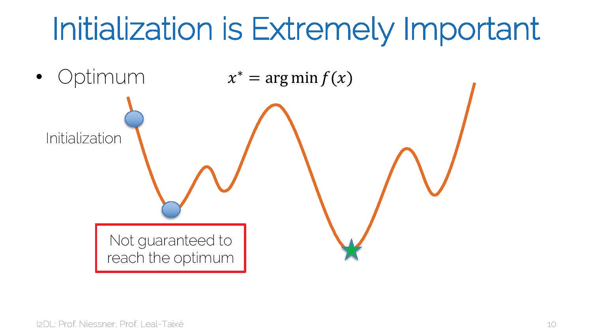
11

Slide 12
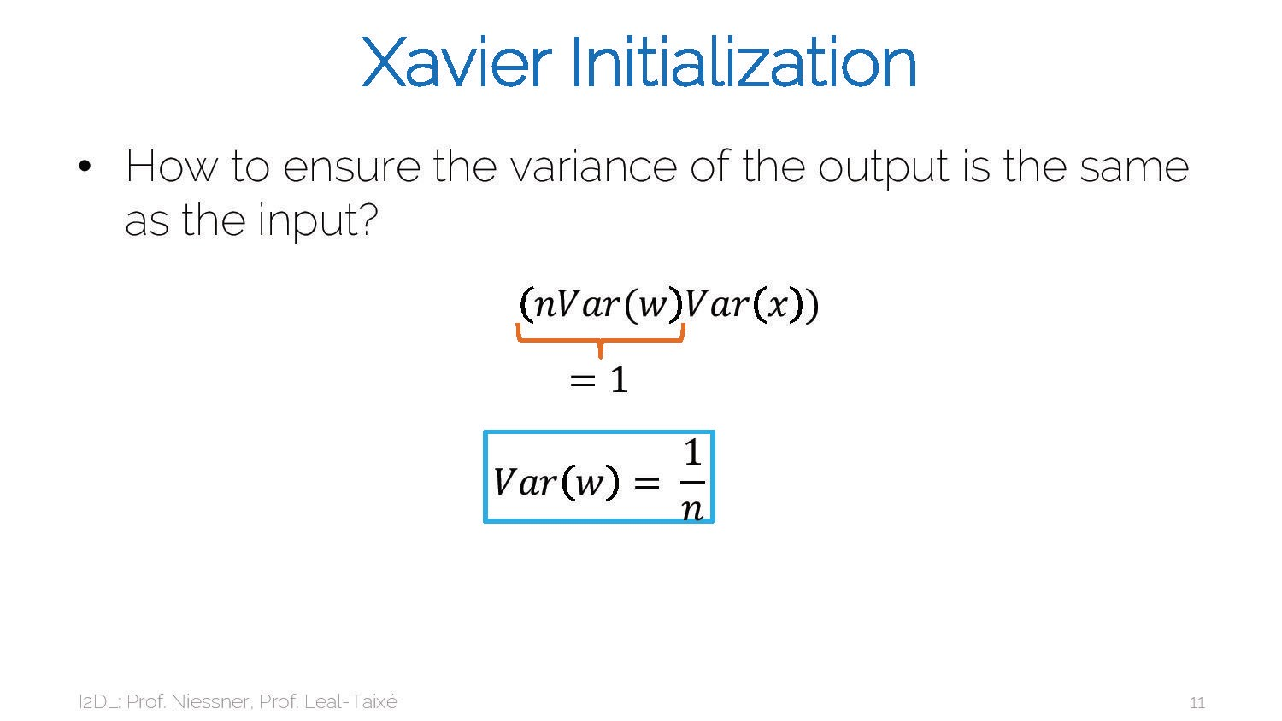
12

Slide 13
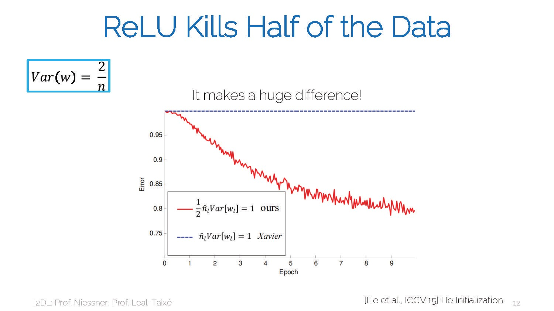
13

Slide 14
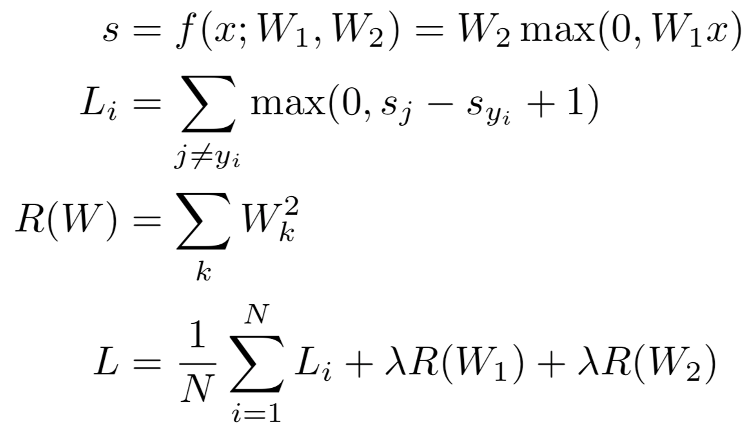
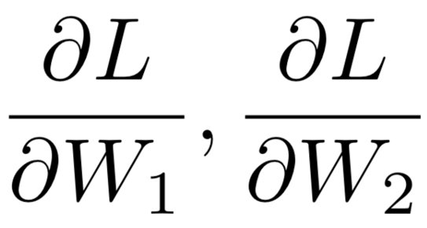
Problem: How to compute gradients?
Nonlinear score function SVM Loss on predictions
Regularization
Total loss: data loss + regularization
If we can compute
then we can learn W₁ and W₂
14

Slide 15
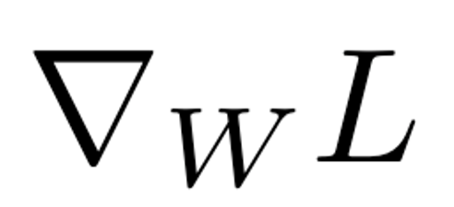
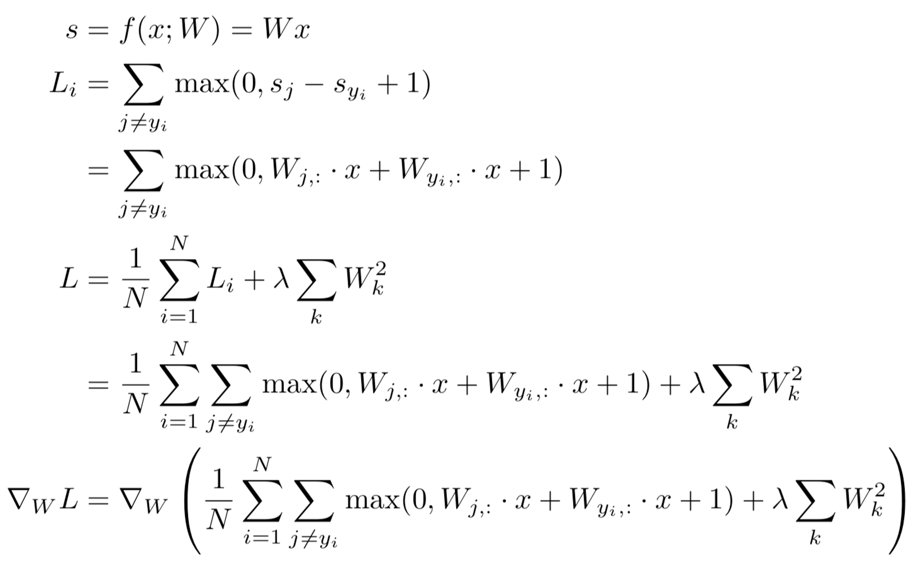
(Bad) Idea: Derive
on paper
Problem: Very tedious: Lots of matrix calculus, need lots of paper
Problem: What if we want to change loss? E.g. use softmax instead of SVM? Need to re-derive from scratch. Not modular!
Problem: Not feasible for very complex models!
15

Slide 16
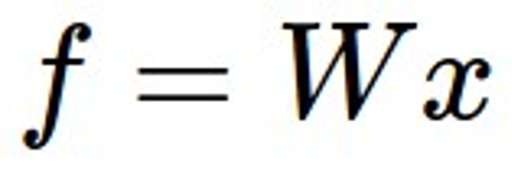
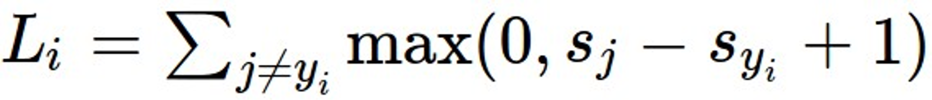
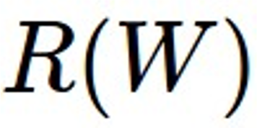
Better Idea: Computational Graphs
x
s (scores)
*
hinge loss
+
L
W
R
16

Slide 17

17

Slide 18
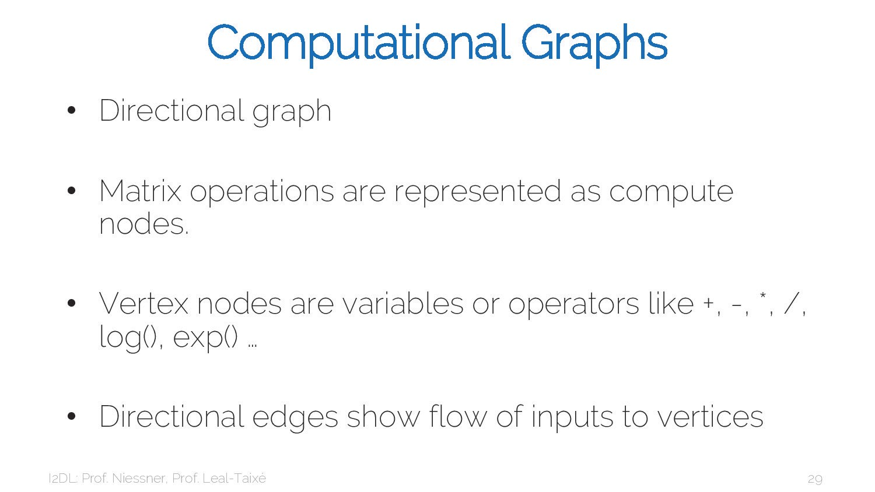
18

Slide 19
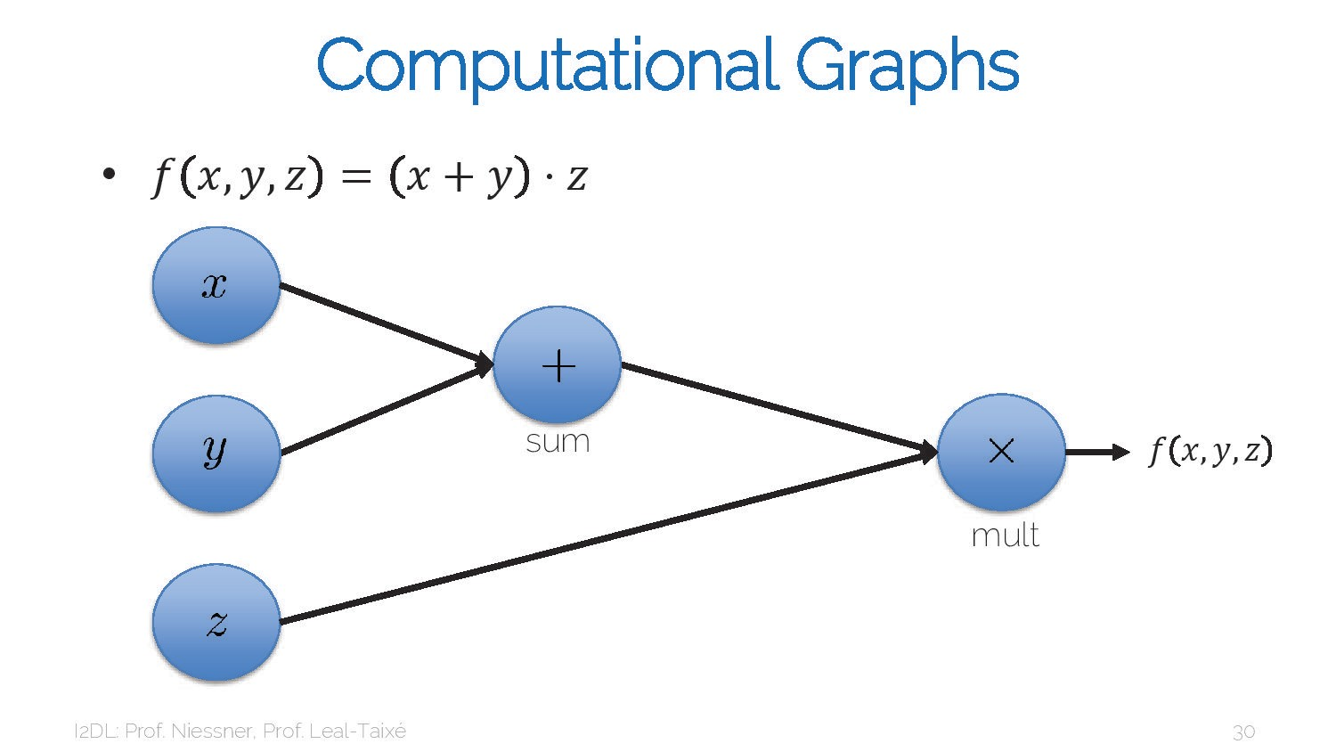
19

Slide 20
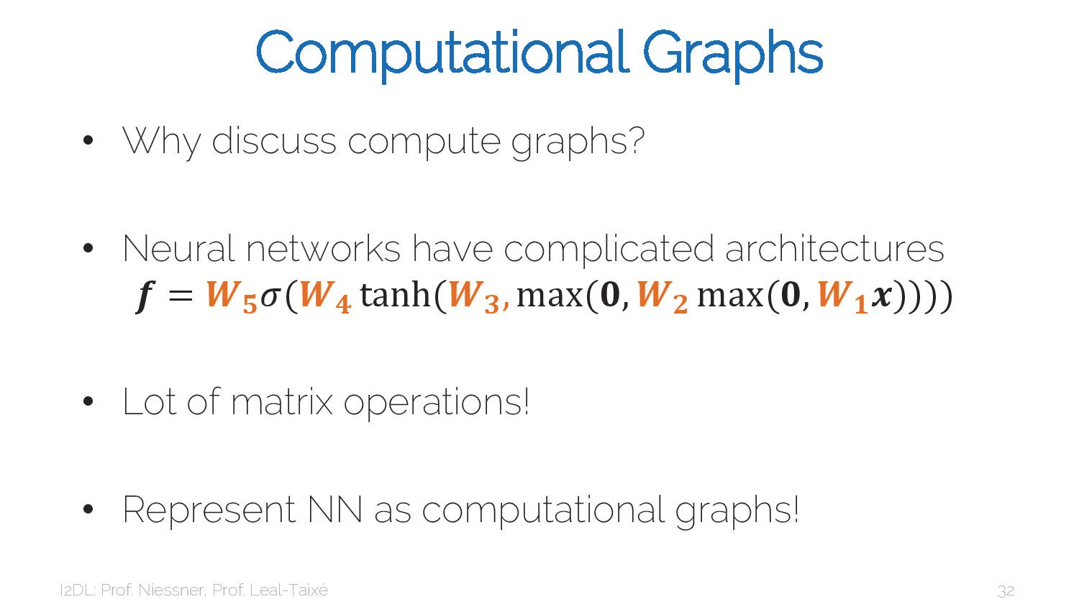
20

Slide 21
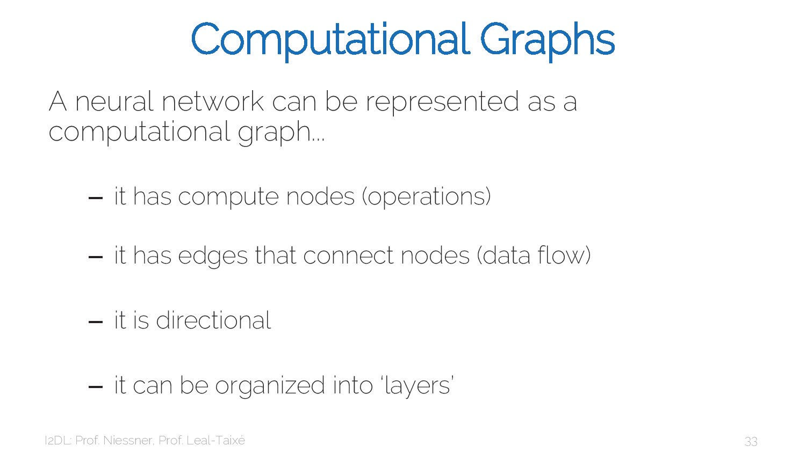
21

Slide 22
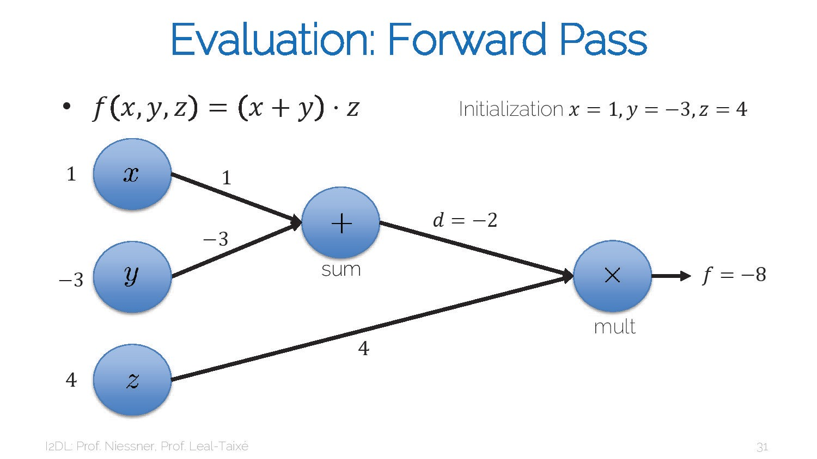
22

Slide 23
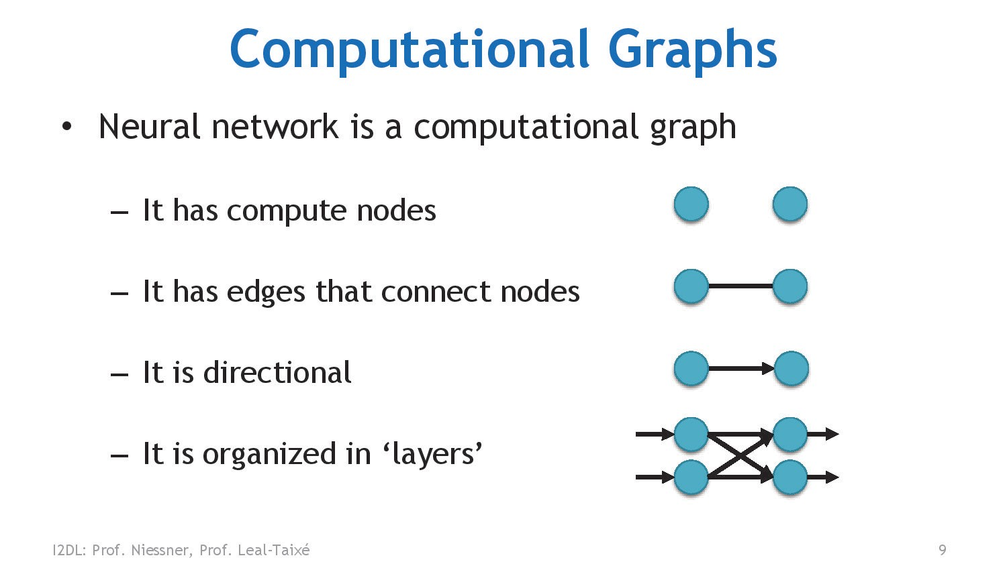
23

Slide 24
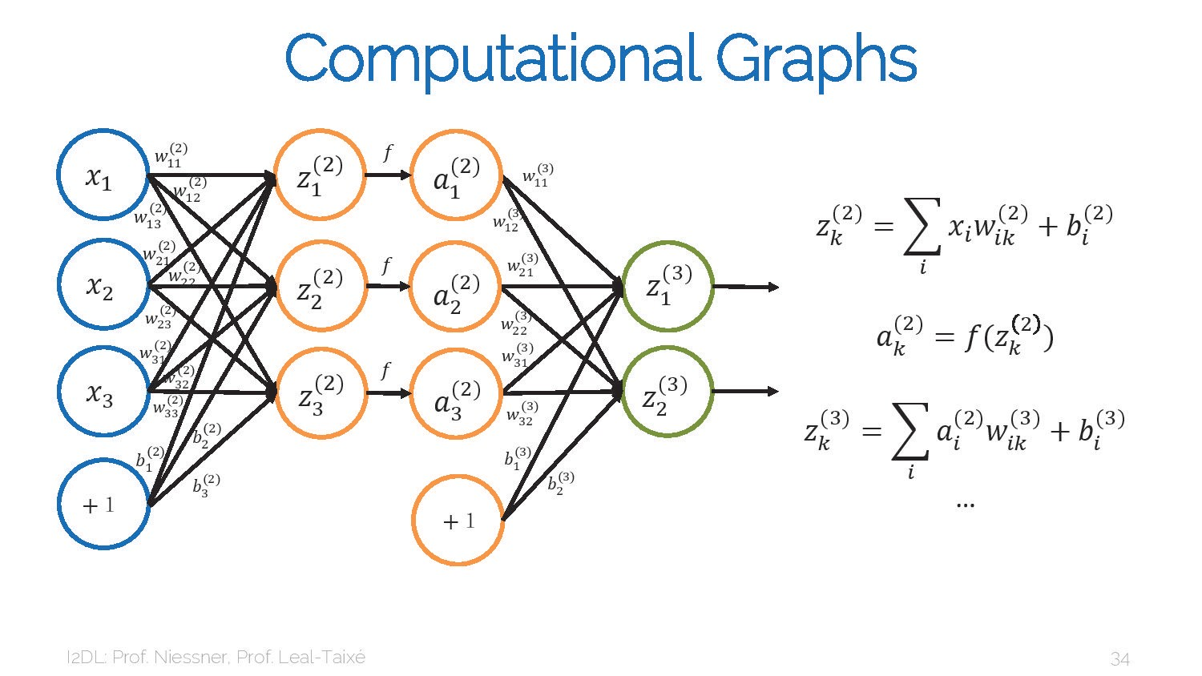
24

Slide 25
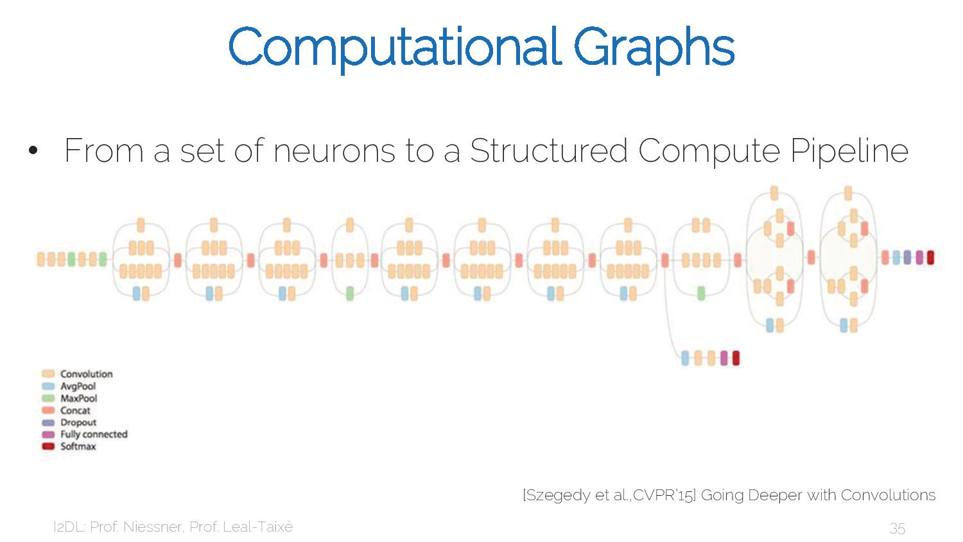
25

Slide 26
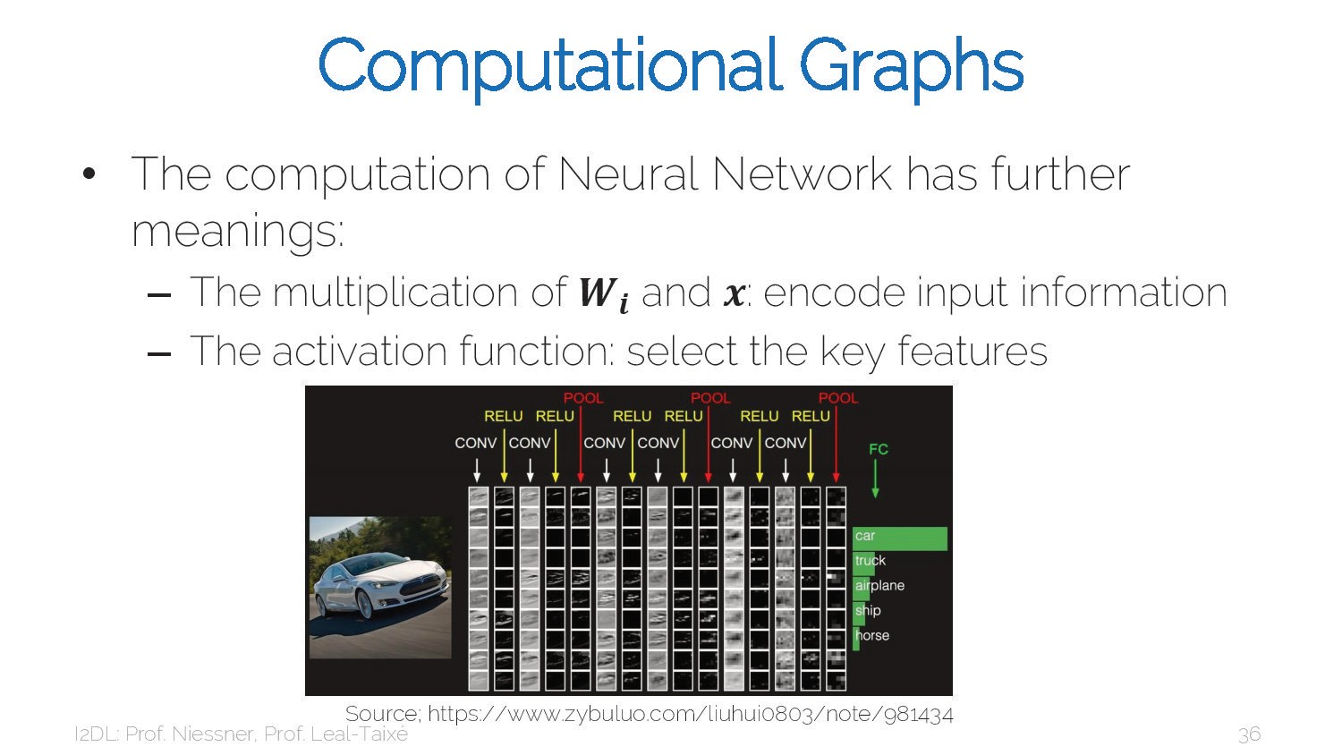
26

Slide 27
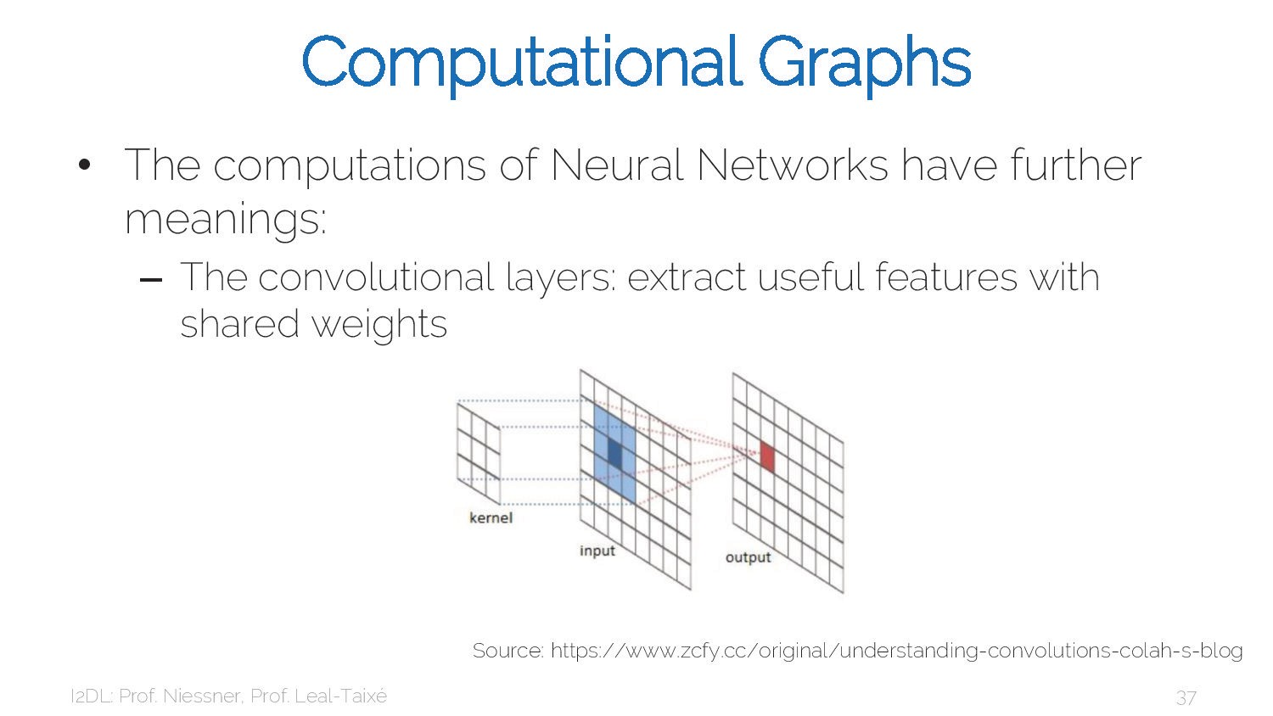
27

Slide 28
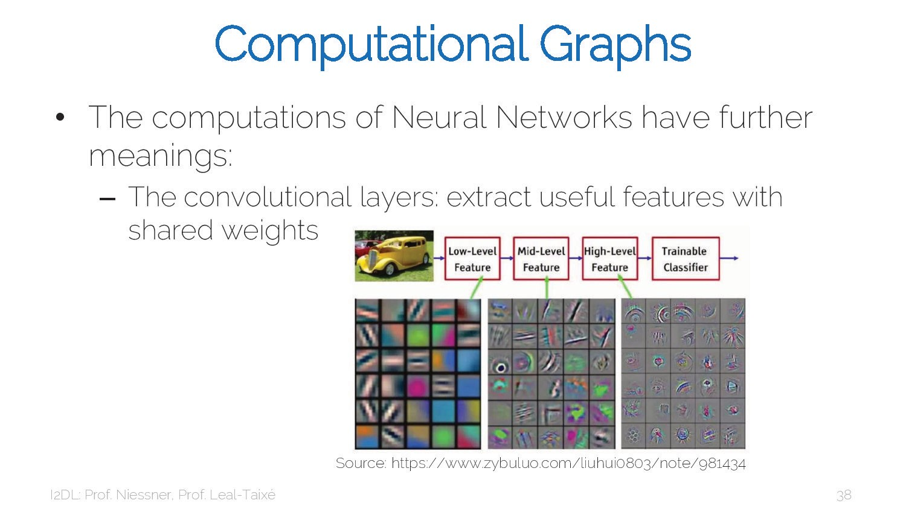
28

Slide 29
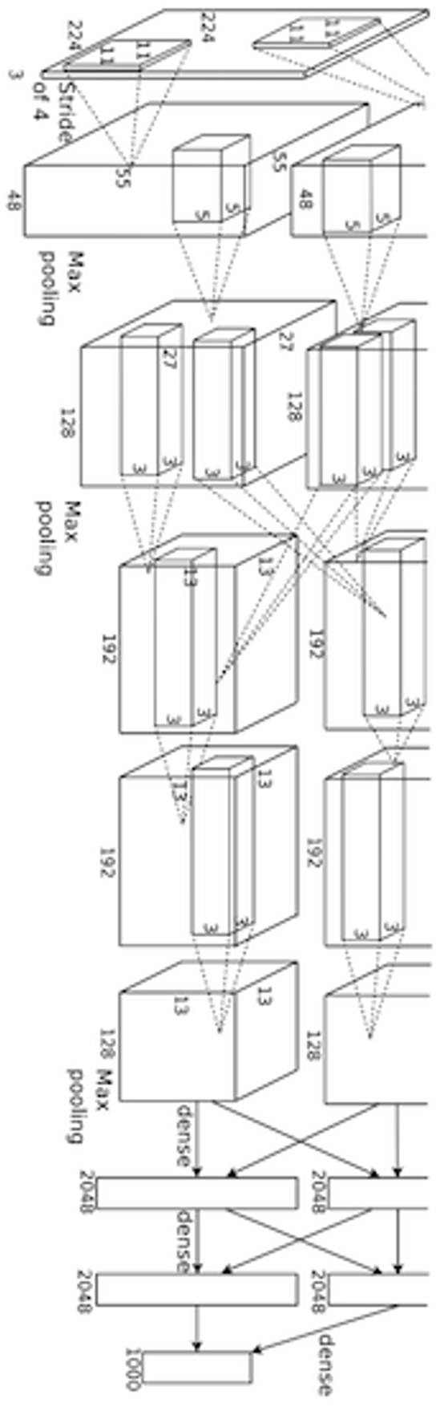
Deep Network (AlexNet)
input image
weights loss
29

Slide 30
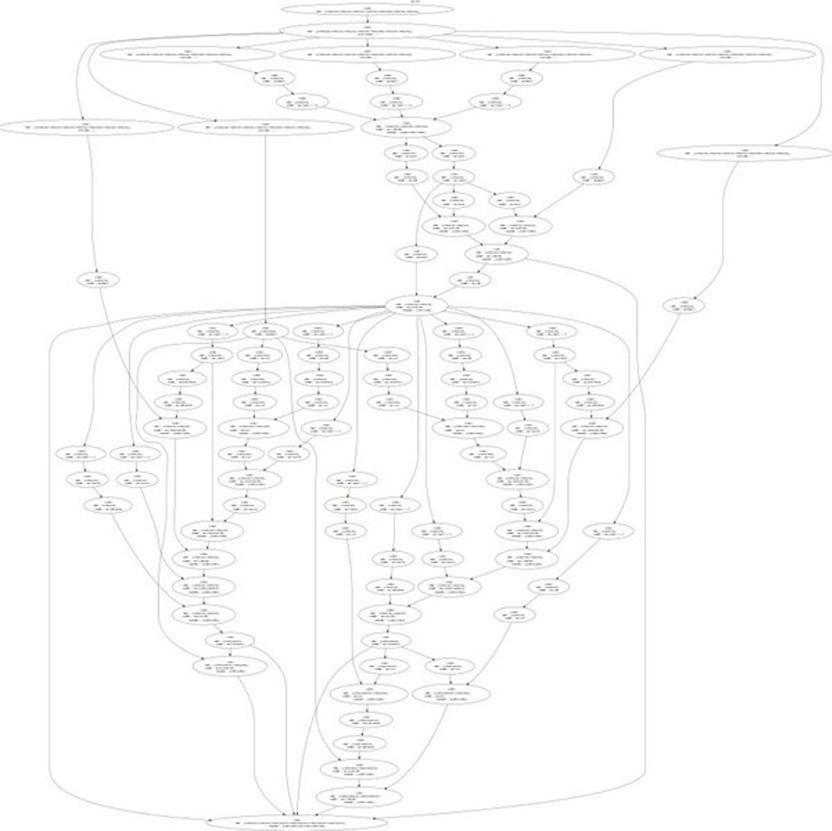
Neural Turing Machine
input image
loss
Figure reproduced with permission from a Twitter post by Andrej Karpathy.
Graves et al, arXiv 2014
30

Slide 31
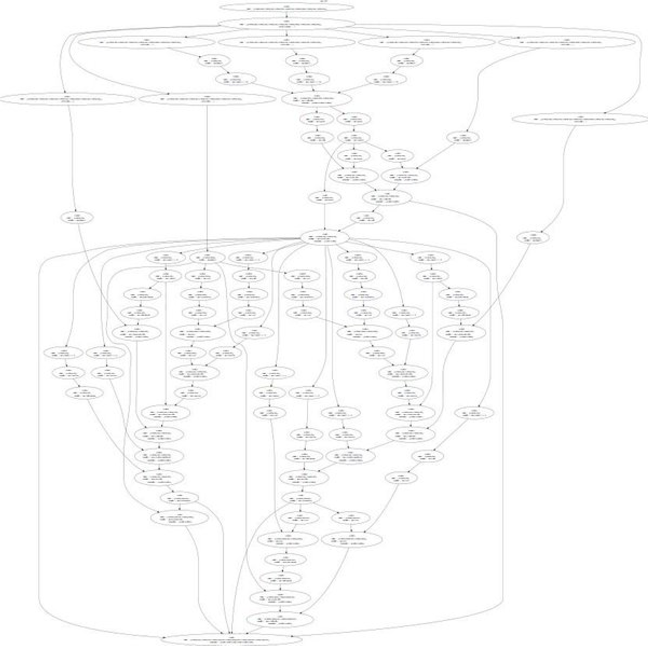

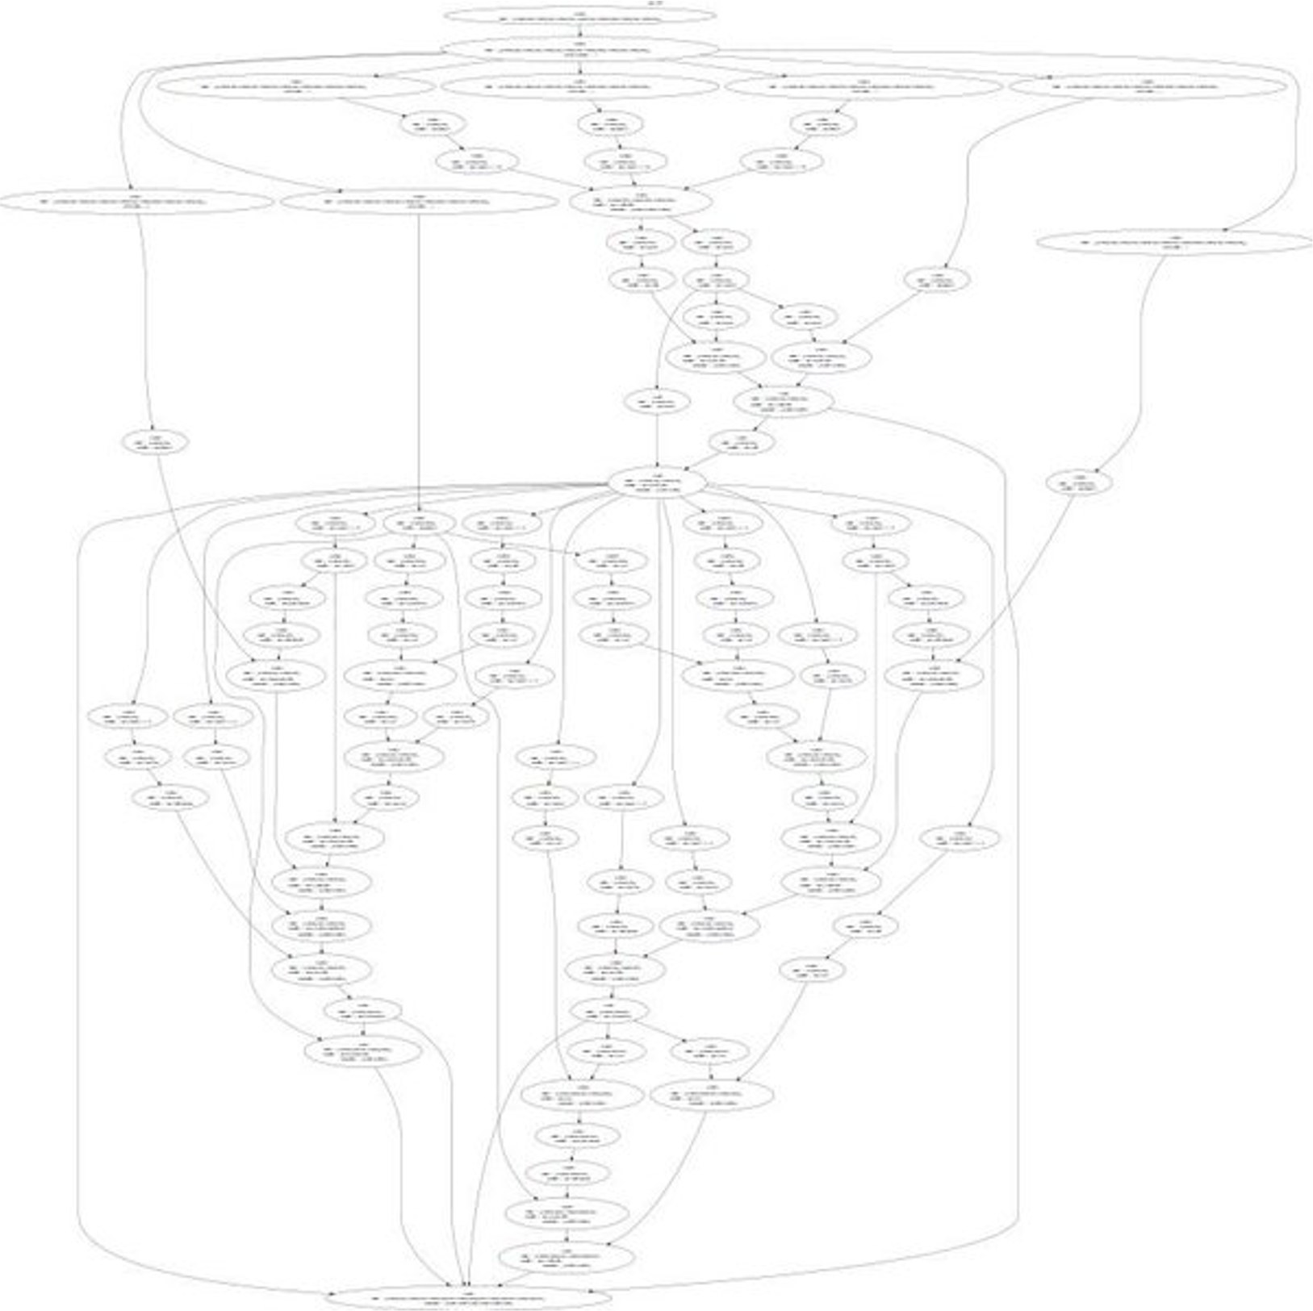

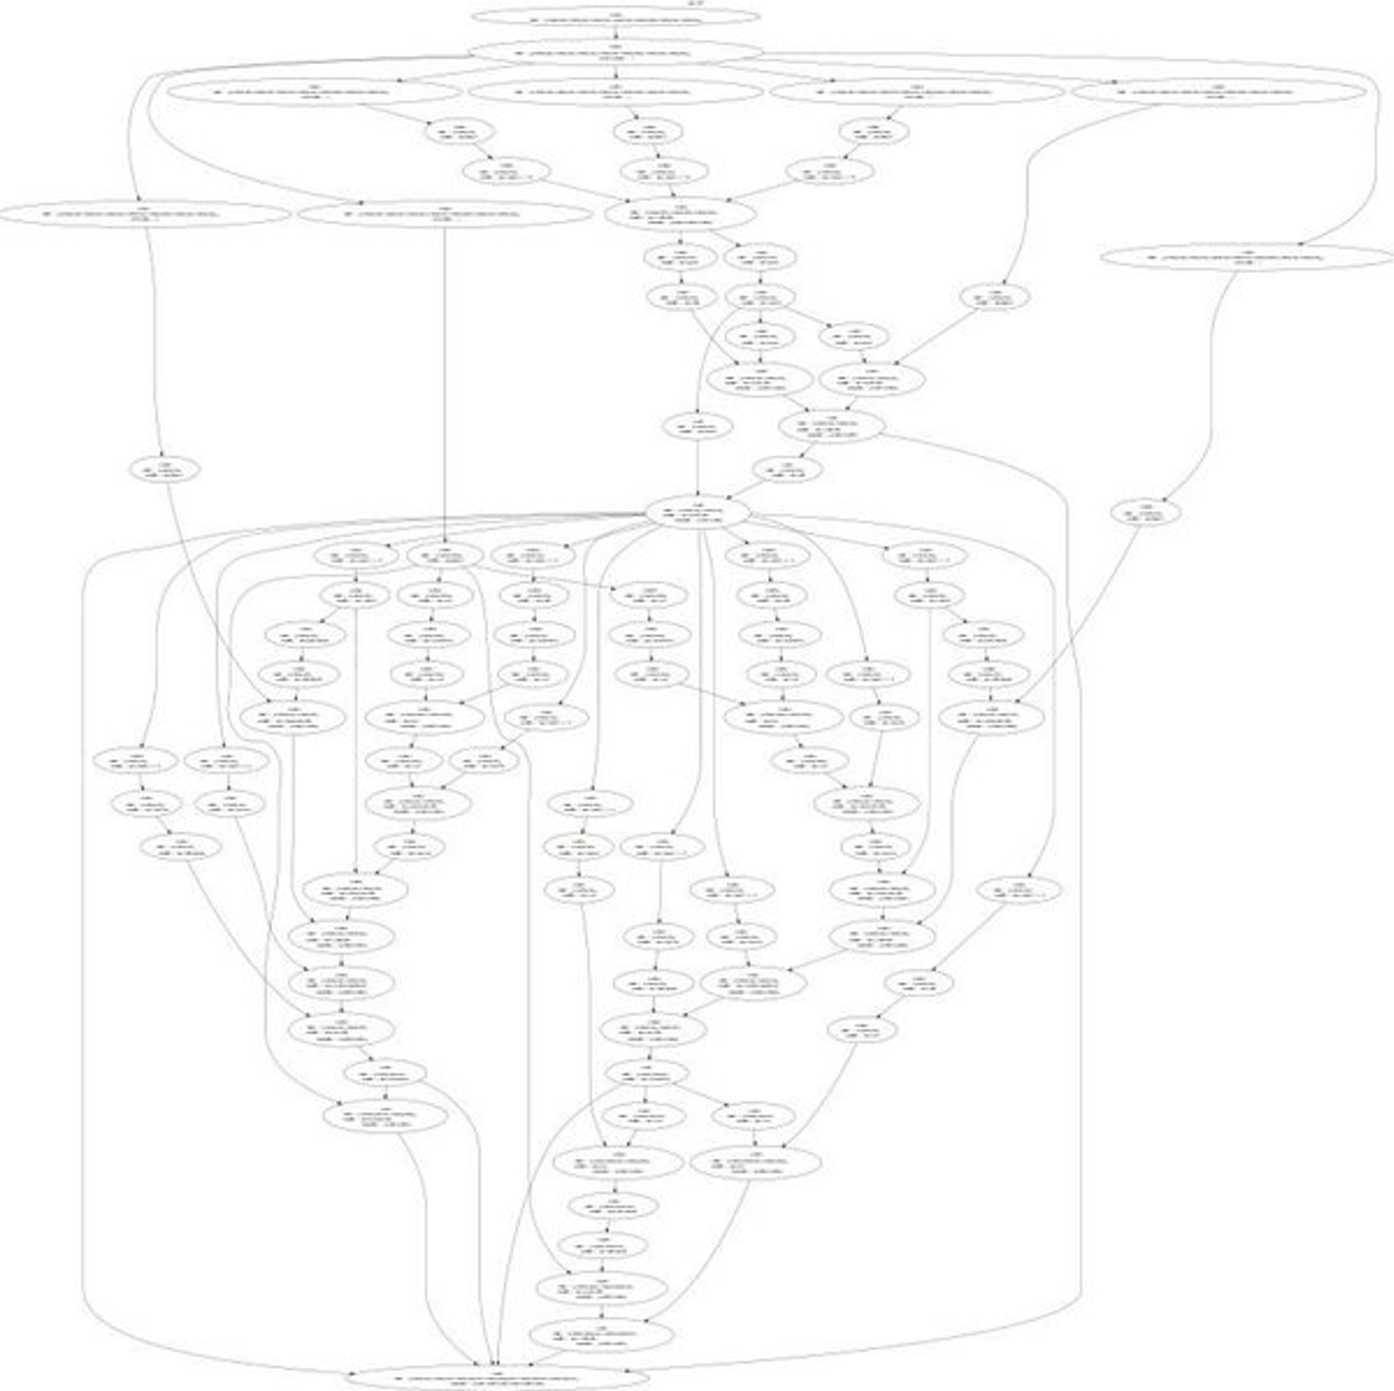
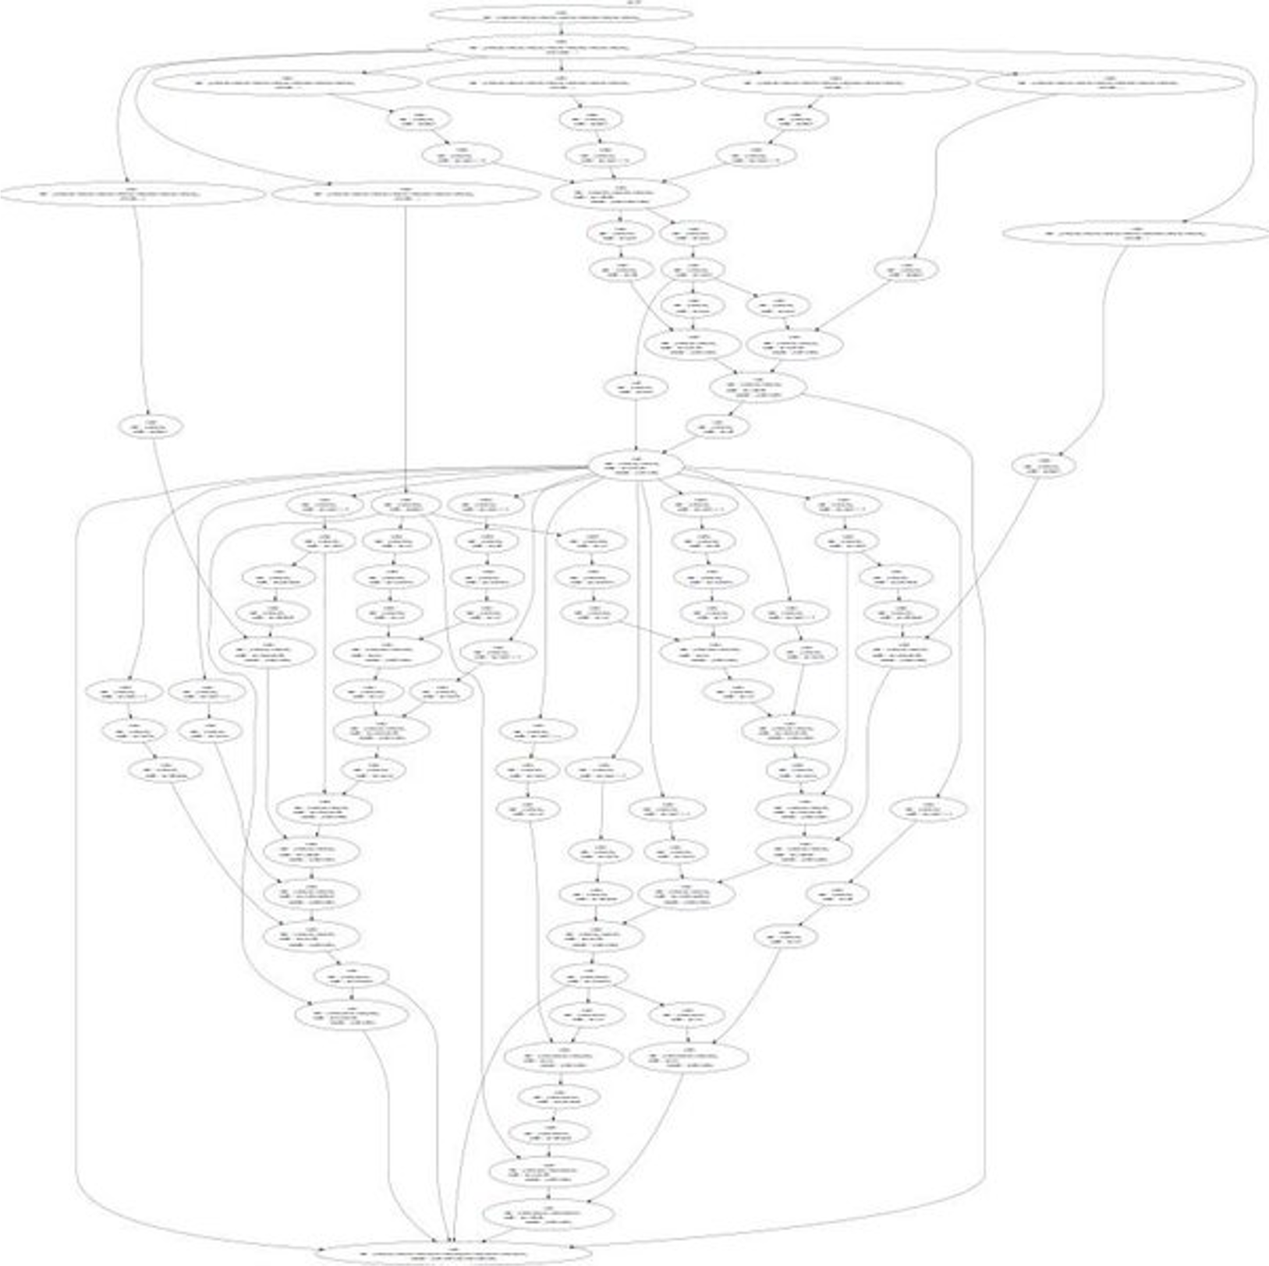
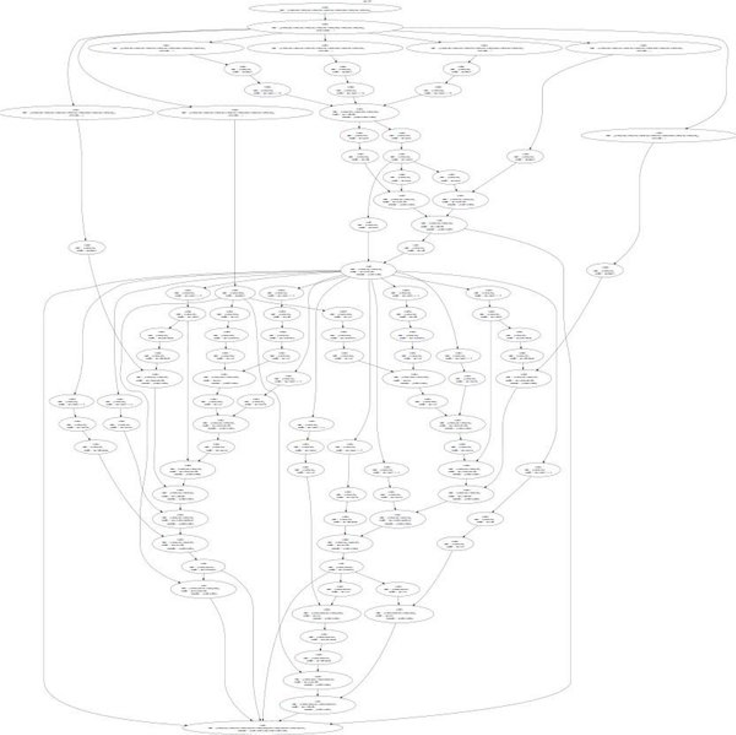






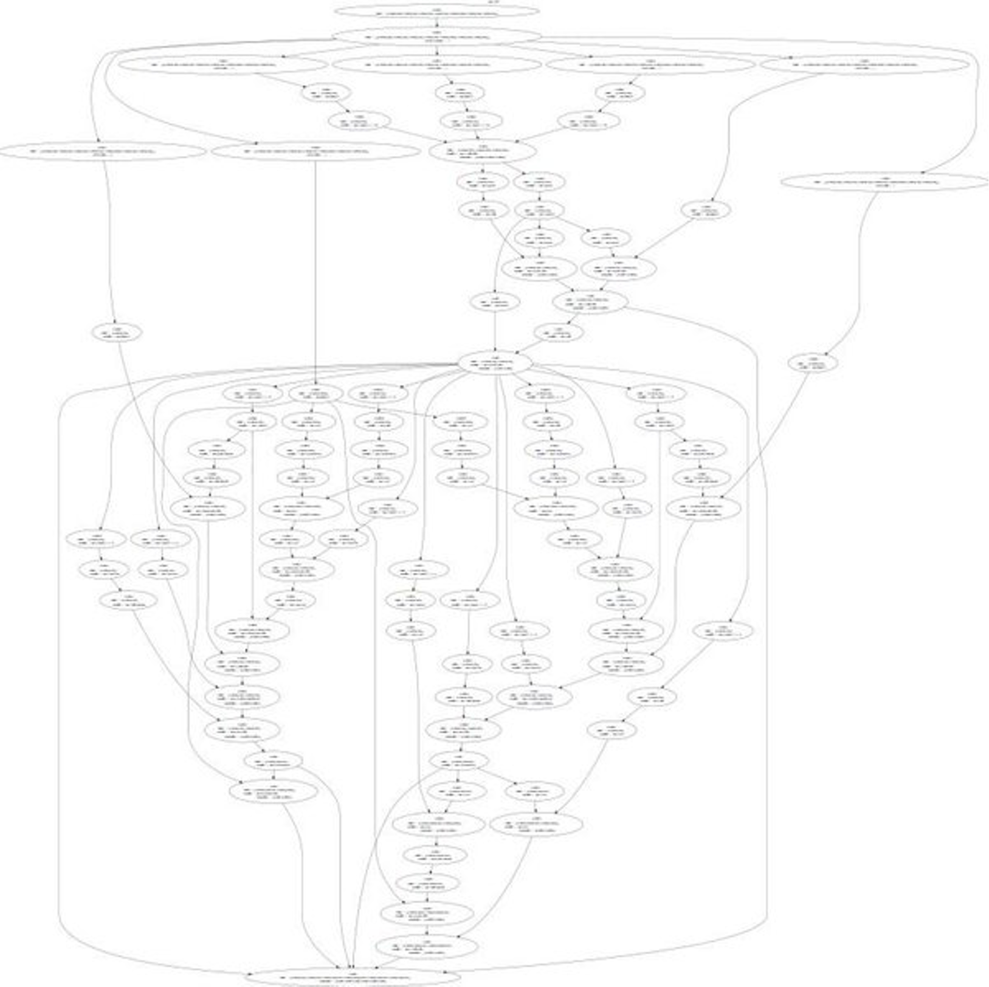



Neural Turing Machine
Graves et al, arXiv 2014
31

Slide 32
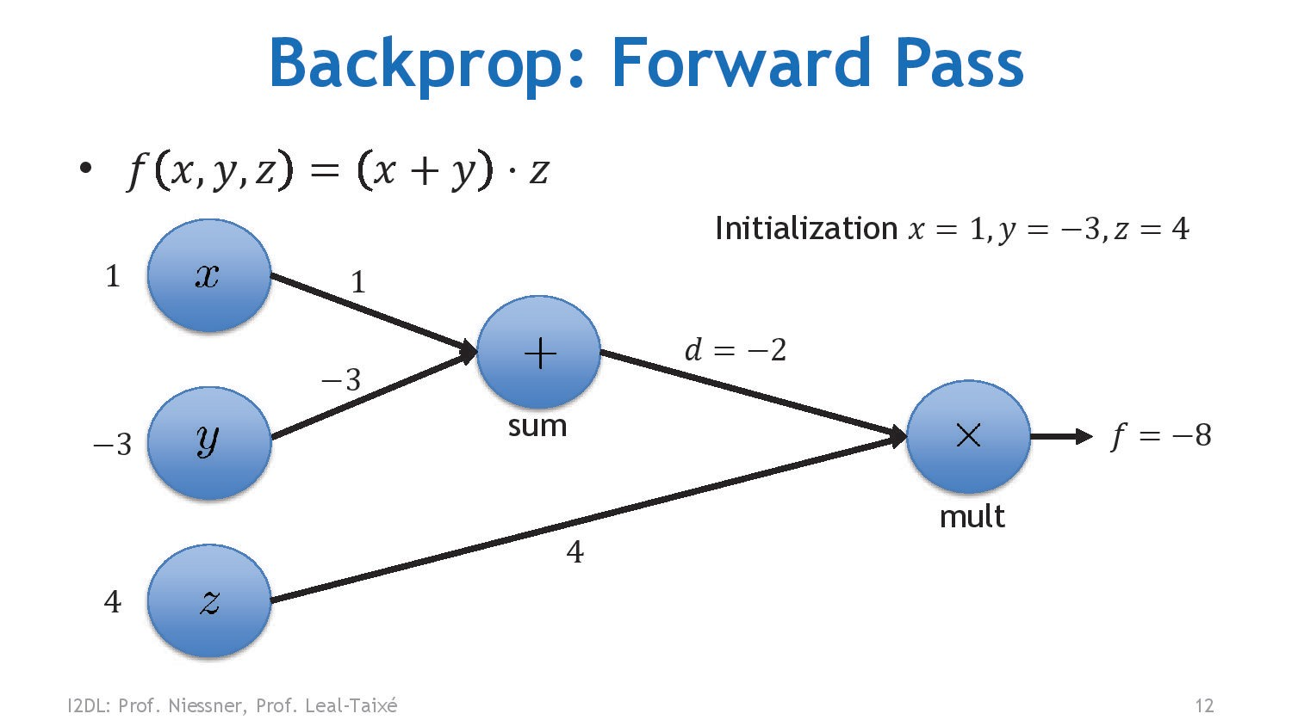
32

Slide 33
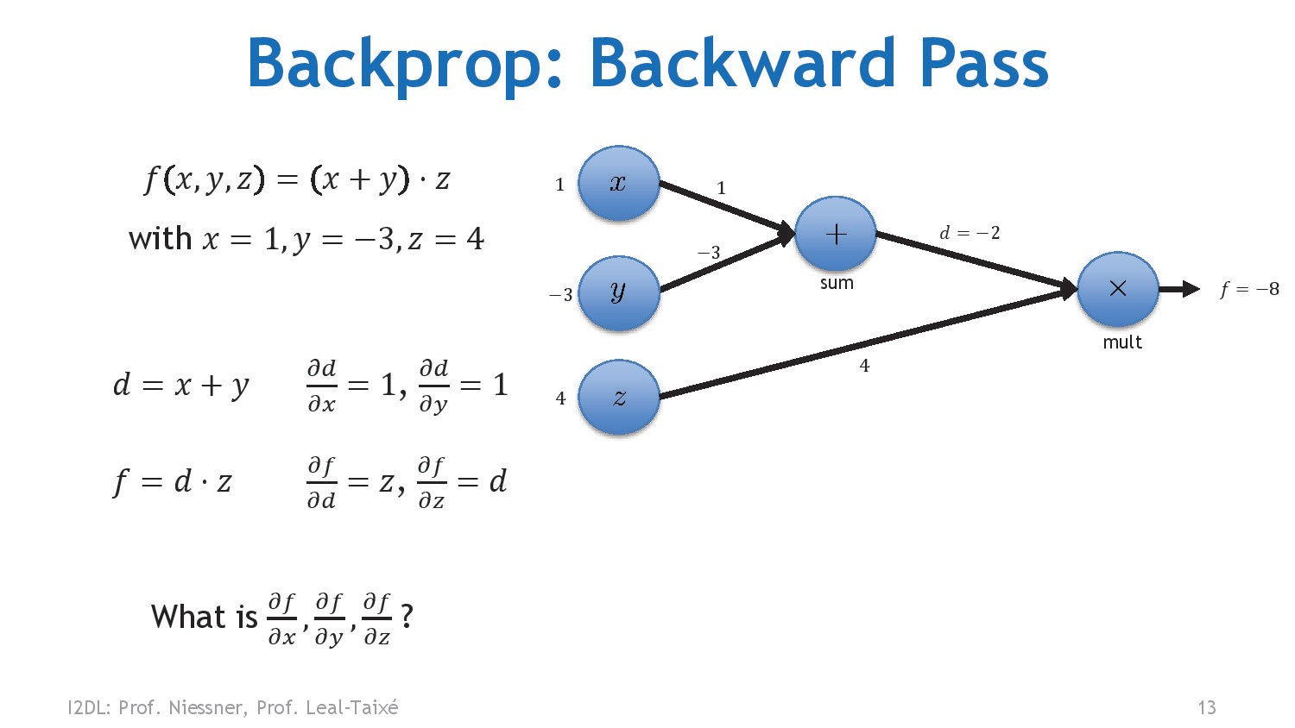
33

Slide 34
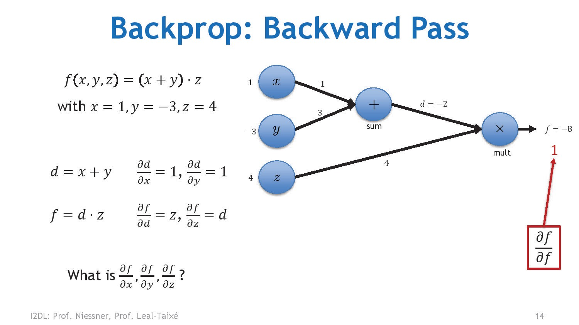
34

Slide 35
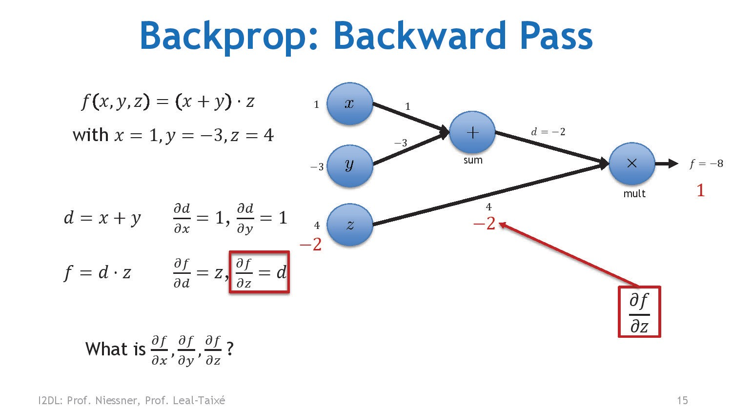
35

Slide 36
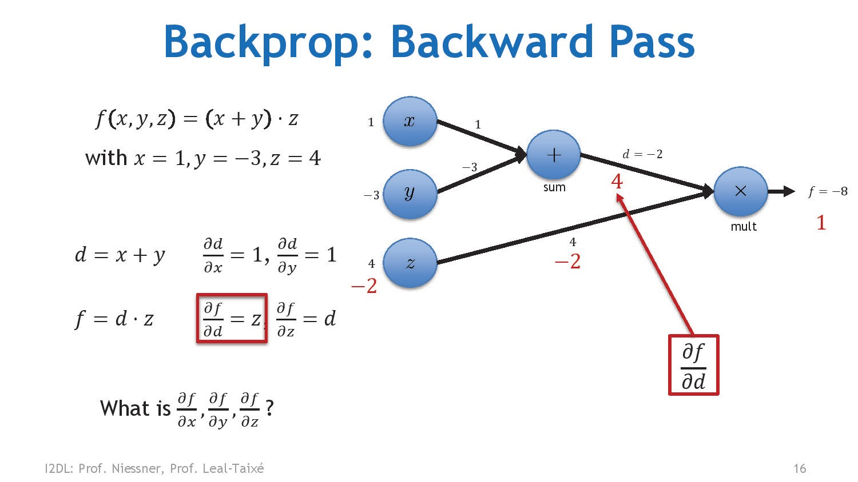
36

Slide 37
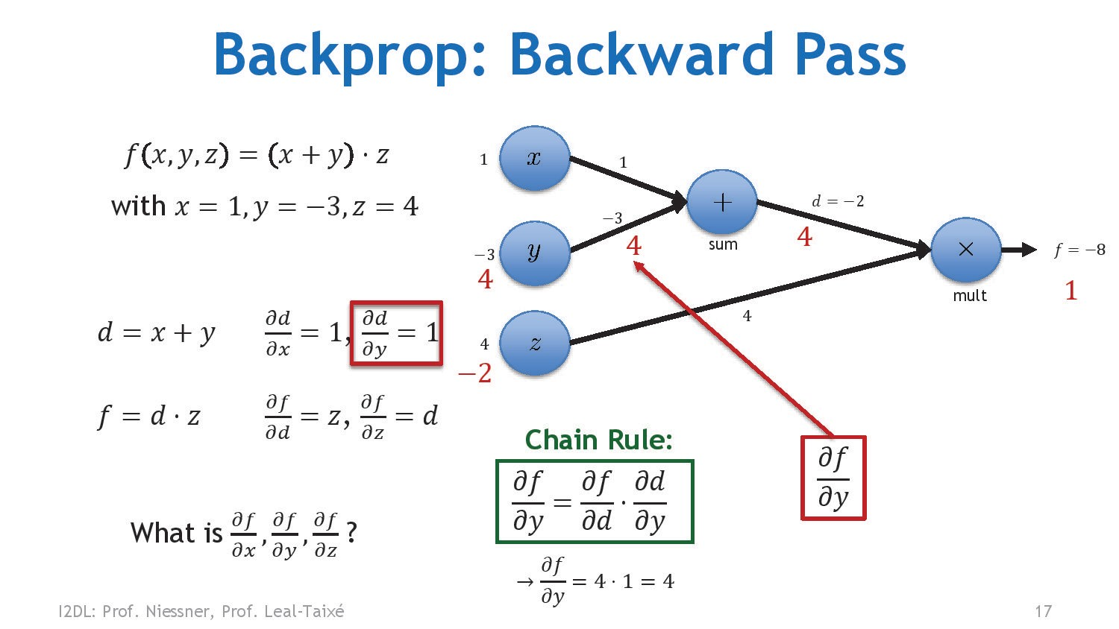
37

Slide 38
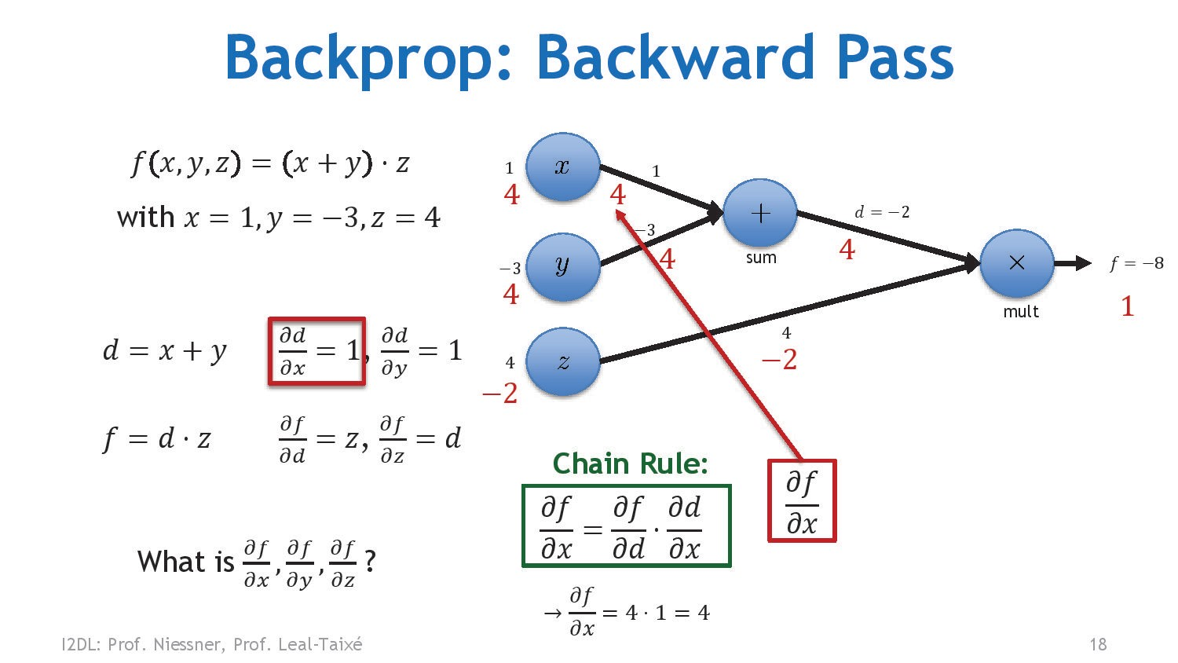
38

Slide 39
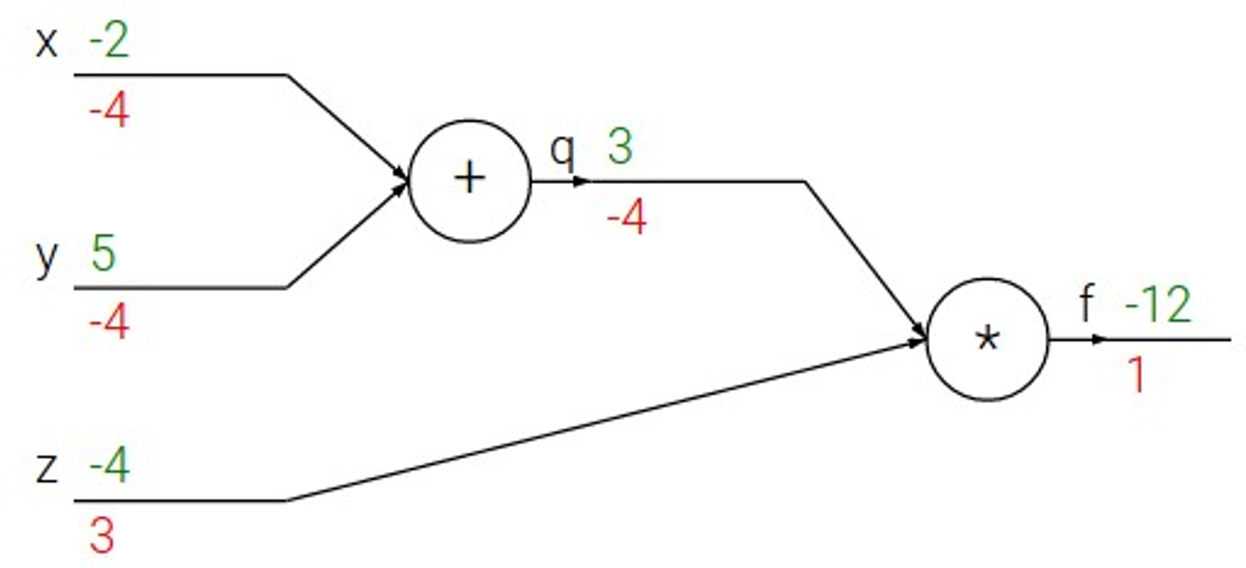
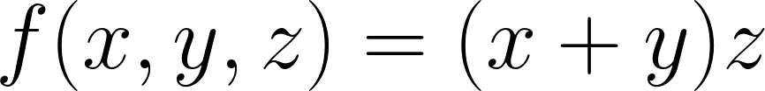
Backpropagation: Simple Example
39

Slide 40
Backpropagation: Simple Example
e.g. x = -2, y = 5, z = -4
40

Slide 41
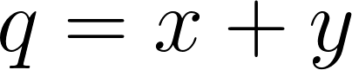

Backpropagation: Simple Example
e.g. x = -2, y = 5, z = -4
1. Forward pass: Compute outputs
41

Slide 42

Backpropagation: Simple Example
e.g. x = -2, y = 5, z = -4
Forward pass: Compute outputs
Backward pass: Compute derivatives
Want:
42

Slide 43

Backpropagation: Simple Example
e.g. x = -2, y = 5, z = -4
Forward pass: Compute outputs
Backward pass: Compute derivatives
Want:
43

Slide 44
Backpropagation: Simple Example
e.g. x = -2, y = 5, z = -4
Forward pass: Compute outputs
Backward pass: Compute derivatives
Want:
44

Slide 45

Backpropagation: Simple Example
e.g. x = -2, y = 5, z = -4
Forward pass: Compute outputs
Backward pass: Compute derivatives
Want:
45

Slide 46

Backpropagation: Simple Example
e.g. x = -2, y = 5, z = -4
Forward pass: Compute outputs
Backward pass: Compute derivatives
Want:
46

Slide 47

Backpropagation: Simple Example
e.g. x = -2, y = 5, z = -4
Forward pass: Compute outputs
Backward pass: Compute derivatives
Want:
47

Slide 48

Backpropagation: Simple Example
e.g. x = -2, y = 5, z = -4
Forward pass: Compute outputs
Backward pass: Compute derivatives
Want:
Lecture 6 - 20
48

Slide 49

Backpropagation: Simple Example
e.g. x = -2, y = 5, z = -4
Forward pass: Compute outputs
Backward pass: Compute derivatives
Want:
49

Slide 50

Backpropagation: Simple Example
e.g. x = -2, y = 5, z = -4
1. Forward pass: Compute outputs
Chain Rule
2. Backward pass: Compute derivatives
Want:
50

Slide 51

Backpropagation: Simple Example
e.g. x = -2, y = 5, z = -4
1. Forward pass: Compute outputs
Chain Rule
2. Backward pass: Compute derivatives
Want:
Downstream Gradient
Local Gradient
Upstream Gradient
51

Slide 52
Backpropagation: Simple Example
e.g. x = -2, y = 5, z = -4
1. Forward pass: Compute outputs
Chain Rule
2. Backward pass: Compute derivatives
Want:
Downstream Gradient
Local Gradient
Upstream Gradient
52

Slide 53


Backpropagation: Simple Example
e.g. x = -2, y = 5, z = -4
1. Forward pass: Compute outputs
Chain Rule
2. Backward pass: Compute derivatives
Want:
Downstream Gradient
Local Gradient
Upstream Gradient
53

Slide 54
Backpropagation: Simple Example
e.g. x = -2, y = 5, z = -4
1. Forward pass: Compute outputs
Chain Rule
2. Backward pass: Compute derivatives
Want:
Downstream Gradient
Local Gradient
Upstream Gradient
54

Slide 55







f
55

Slide 56

f
Upstream gradient
56

Slide 57


f
Local gradients
Upstream gradient
57

Slide 58










f
Local gradients
Downstream gradients
Upstream gradient
Lecture 6 - 30
58

Slide 59
f
Local gradients
Downstream gradients
Upstream gradient
59

Slide 60

60

Slide 61

61

Slide 62

62

Slide 63

63

Slide 64

64

Slide 65

65

Slide 66


Another Example
66

Slide 67
Another Example
Forward pass: Compute outputs
67

Slide 68
Another Example
Backward pass: Compute gradients
Base Case
68

Slide 69

Another Example
Backward pass: Compute gradients
Local Gradient
Downstream Gradient
Upstream Gradient
69

Slide 70

Another Example
Backward pass: Compute gradients
Local Gradient
Downstream Gradient
Upstream Gradient
70

Slide 71

Another Example
Backward pass: Compute gradients
Local Gradient
Downstream Gradient
Upstream Gradient
71

Slide 72

Another Example
Backward pass: Compute gradients
Local Gradient
Downstream Gradient
Upstream Gradient
72

Slide 73

Another Example
Backward pass: Compute gradients
Local Gradient
Upstream Gradient
Downstream Gradient
73

Slide 74
Another Example
Backward pass: Compute gradients
Local Gradient
Downstream Gradient
Upstream Gradient
Lecture 6 - 40
74

Slide 75

Another Example
Downstream Gradient
Upstream Gradient
Backward pass: Compute gradients
Local Gradient
75

Slide 76
Downstream Gradient
Upstream Gradient
Backward pass: Compute gradients
Local Gradient
76

Slide 77


Another Example
Backward pass: Compute gradients
Computational graph is not unique: we can use primitives that have simple local gradients
Sigmoid
77

Slide 78
Another Example
Backward pass: Compute gradients
Computational graph is not unique: we can use primitives that have simple local gradients
Sigmoid
Sigmoid local gradient:
78

Slide 79
Another Example
Backward pass: Compute gradients
Computational graph is not unique: we can use primitives that have simple local gradients
Sigmoid
[Downstream] = [Local] * [Upstream]
= (1 – 0.73) * 0.73 * 1.0 = 0.2
Sigmoid local gradient:
79

Slide 80

80

Slide 81

81

Slide 82

82

Slide 83

83

Slide 84

84

Slide 85

85

Slide 86

86

Slide 87
Patterns in Gradient Flow
add gate: gradient distributor 3
2
4
+
7
2
2
87

Slide 88
Patterns in Gradient Flow
add gate: gradient distributor 3
2
4
+
7
2
2
copy gate: gradient adder
7
7
4+2=6
4
7
2
88

Slide 89
Patterns in Gradient Flow
add gate: gradient distributor 3
mul gate: “swap multiplier” 2
2
4
5*3=15
3
+
7
2
×
6
5
2
copy gate: gradient adder
7
7
4+2=6
2*5=10
4
7
2
89

Slide 90
add gate: gradient distributor 3
mul gate: “swap multiplier” 2
2
4
5*3=15
3
+
7
2
×
6
5
2
copy gate: gradient adder
7
7
4+2=6
2*5=10
max gate: gradient router
4 0
5
4
7
2
5
9
max
9
90

Slide 91

91

Slide 92

92

Slide 93

93

Slide 94

94

Slide 95

95

Slide 96

96

Slide 97

97

Slide 98

98

Slide 99

99

Slide 100

100

Slide 101

101

Slide 102

102

Slide 103

103

Slide 104

104

Slide 105

105

Slide 106

106

Slide 107

107

Slide 108

108

Slide 109

109

Slide 110

110

Slide 111

111

Slide 112

112

Slide 113

113

Slide 114

114

Slide 115

115

Slide 116

116

Slide 117

117

Slide 118

118

Slide 119

119

Slide 120




Backprop Implementation:
”Flat” gradient code:
Forward pass: Compute output
Lecture 6 - 50
120

Slide 121

Backprop Implementation:
”Flat” gradient code:
Forward pass: Compute output
Backward pass: Compute grads
121

Slide 122
Backprop Implementation:
”Flat” gradient code:
Forward pass: Compute output
Base case
122

Slide 123
Backprop Implementation:
”Flat” gradient code:
Forward pass: Compute output
Sigmoid
123

Slide 124
Backprop Implementation:
”Flat” gradient code:
Forward pass: Compute output
Add
124

Slide 125
Backprop Implementation:
”Flat” gradient code:
Forward pass: Compute output
Add
125

Slide 126
Backprop Implementation:
”Flat” gradient code:
Forward pass: Compute output
Multiply
126

Slide 127
Backprop Implementation:
”Flat” gradient code:
Forward pass: Compute output
Multiply
127

Slide 128

Example: PyTorch Autograd Functions
x
z
Need to stash some values for use in backward
Upstream gradient
Multiply upstream and local gradients
*
y
(x,y,z are scalars)
128

Slide 129


Example: PyTorch operators
129

Slide 130

PyTorch sigmoid layer
Source
September 23, 2019
130

Slide 131

PyTorch sigmoid layer
Forward
Source
September 23, 2019
131

Slide 132

PyTorch sigmoid layer
Forward
Forward actually defined elsewhere...
Source
September 23, 2019
132

Slide 133

PyTorch sigmoid layer
Forward
Backward
Source
September 23, 2019
133

Slide 134
So far: backprop with scalars
What about vector-valued functions?
134

Slide 135


Recap: Vector Derivatives
Regular derivative:
If x changes by a small amount, how much will y change?
135

Slide 136



Recap: Vector Derivatives
Regular derivative:
Derivative is Gradient:
If x changes by a small amount, how much will y change?
For each element of x, if it changes by a small amount then how much will y change?
136

Slide 137



Recap: Vector Derivatives
Regular derivative:
Derivative is Gradient:
Derivative is Jacobian:
If x changes by a small amount, how much will y change?
For each element of x, if it changes by a small amount then how much will y change?
For each element of x, if it changes by a small amount then how much will each element of y change?
Lecture 6 - 70
137

Slide 138



Backprop with Vectors
D_{x}
D_{z}
f
D_{y}
138

Slide 139

Backprop with Vectors
D_{x}
Loss L still a scalar!
D_{z}
f
D_{z}
D_{y}
Upstream Gradient For each element of z, how much does it influence L?
139

Slide 140


Backprop with Vectors
D_{x}
Loss L still a scalar!
Local Jacobian matrices
D_{z}
[D_{x} x D_{z}]
f
[D_{y} x D_{z}]
D_{z}
D_{y}
Upstream Gradient For each element of z, how much does it influence L?
140

Slide 141


Backprop with Vectors
Loss L still a scalar!
D_{x}
Local Jacobian matrices
D_{x}
D_{z}
[D_{x} x D_{z}]
f
[D_{y} x D_{z}]
Downstream Gradients
Matrix-vector multiply
D_{z}
D_{y}
Upstream Gradient For each element of z, how much does it influence L?
D_{y}
141

Slide 142
Backprop with Vectors
4D input x:
4D output y: [ 1 ]
[ 0 ]
[ 3 ]
[ 0 ]
[ 1 ]
[ -2 ]
[ 3 ]
[ -1 ]
f(x) = max(0,x)
(elementwise)
142

Slide 143
Backprop with Vectors
4D input x:
4D output y: [ 1 ]
[ 0 ]
[ 3 ]
[ 0 ]
[ 1 ]
[ -2 ]
[ 3 ]
[ -1 ]
f(x) = max(0,x)
(elementwise)
4D dL/dy: [ 4 ]
[ -1 ]
[ 5 ]
[ 9 ]
Upstream gradient
143

Slide 144
Backprop with Vectors
4D input x:
4D output y: [ 1 ]
[ 0 ]
[ 3 ]
[ 0 ]
[ 1 ]
[ -2 ]
[ 3 ]
[ -1 ]
f(x) = max(0,x)
(elementwise)
Jacobian dy/dx [ 1 0 0 0 ]
[ 0 0 0 0 ]
[ 0 0 1 0 ]
[ 0 0 0 0 ]
4D dL/dy: [ 4 ]
[ -1 ]
[ 5 ]
[ 9 ]
Upstream gradient
144

Slide 145
Backprop with Vectors
4D input x:
4D output y: [ 1 ]
[ 0 ]
[ 3 ]
[ 0 ]
[ 1 ]
[ -2 ]
[ 3 ]
[ -1 ]
f(x) = max(0,x)
(elementwise)
[dy/dx] [dL/dy] [ 1 0 0 0 ] [ 4 ]
[ 0 0 0 0 ] [ -1 ]
[ 0 0 1 0 ] [ 5 ]
[ 0 0 0 0 ] [ 9 ]
4D dL/dy: [ 4 ]
[ -1 ]
[ 5 ]
[ 9 ]
Upstream gradient
145

Slide 146
Backprop with Vectors
4D input x:
4D output y: [ 1 ]
[ 0 ]
[ 3 ]
[ 0 ]
[ 1 ]
[ -2 ]
[ 3 ]
[ -1 ]
f(x) = max(0,x)
(elementwise)
4D dL/dx: [ 4 ]
[ 0 ]
[ 5 ]
[ 0 ]
[dy/dx] [dL/dy] [ 1 0 0 0 ] [ 4 ]
[ 0 0 0 0 ] [ -1 ]
[ 0 0 1 0 ] [ 5 ]
[ 0 0 0 0 ] [ 9 ]
4D dL/dy: [ 4 ]
[ -1 ]
[ 5 ]
[ 9 ]
Upstream gradient
146

Slide 147
Backprop with Vectors
Jacobian is sparse: off-diagonal entries all zero! Never explicitly form Jacobian; instead use implicit multiplication
4D output y:
4D input x:
[ 1 ]
[ -2 ]
[ 3 ]
[ -1 ]
f(x) = max(0,x)
(elementwise)
[ 1 ]
[ 0 ]
[ 3 ]
[ 0 ]
4D dL/dx: [ 4 ]
[ 0 ]
[ 5 ]
[ 0 ]
[dy/dx] [dL/dy] [ 1 0 0 0 ] [ 4 ]
[ 0 0 0 0 ] [ -1 ]
[ 0 0 1 0 ] [ 5 ]
[ 0 0 0 0 ] [ 9 ]
4D dL/dy: [ 4 ]
[ -1 ]
[ 5 ]
[ 9 ]
Upstream gradient
Lecture 6 - 80
147

Slide 148

Backprop with Vectors
Jacobian is sparse: off-diagonal entries all zero! Never explicitly form Jacobian; instead use implicit multiplication
4D output y:
4D input x:
[ 1 ]
[ -2 ]
[ 3 ]
[ -1 ]
f(x) = max(0,x)
(elementwise)
[ 1 ]
[ 0 ]
[ 3 ]
[ 0 ]
4D dL/dx: [ 4 ]
[ 0 ]
[ 5 ]
[ 0 ]
[dy/dx] [dL/dy]
4D dL/dy: [ 4 ]
[ -1 ]
[ 5 ]
[ 9 ]
Upstream gradient
148

Slide 149



Backprop with Matrices (or Tensors):
[D_{x}×M_{x}]
[D_{z}×M_{z}]
[D_{y}×M_{y}]
149

Slide 150
Loss L still a scalar!
Backprop with Matrices (or Tensors):
[D_{x}×M_{x}]
dL/dx always has the same shape as x!
[D_{z}×M_{z}]
[D_{y}×M_{y}]
150

Slide 151

Loss L still a scalar!
Backprop with Matrices (or Tensors):
[D_{x}×M_{x}]
dL/dx always has the same shape as x!
[D_{z}×M_{z}]
[D_{z}×M_{z}]
Upstream gradient For each element of z, how much does it influence L?
[D_{y}×M_{y}]
151

Slide 152


Backprop with Matrices (or Tensors):
Loss L still a scalar!
[D_{x}×M_{x}]
dL/dx always has the same shape as x!
Local Jacobian matrices
[(D_{x}×M_{x})×(D_{z}×M_{z})]
[D_{z}×M_{z}]
[(D_{y}×M_{y})×(D_{z}×M_{z})]
[D_{y}×M_{y}]
[D_{z}×M_{z}]
Upstream gradient For each element of z, how much does it influence L?
For each element of y, how much does it influence each element of z?
152

Slide 153






Backprop with Matrices (or Tensors):
Loss L still a scalar!
[D_{x}×M_{x}]
dL/dx always has the same shape as x!
Local Jacobian matrices
[(D_{x}×M_{x})×(D_{z}×M_{z})]
[D_{x}×M_{x}]
[D_{z}×M_{z}]
Matrix-vector multiply
[(D_{y}×M_{y})×(D_{z}×M_{z})]
[D_{y}×M_{y}]
[D_{z}×M_{z}]
Upstream gradient For each element of z, how much does it influence L?
[D_{y}×M_{y}]
For each element of y, how much does it influence each element of z?
153

Slide 154

Example: Matrix Multiplication
y: [N×M]
[-1 -1 2 6 ]
[ 5 2 11 7 ]
x: [N×D]
[ 2 1 -3 ]
[ -3 4 2 ]
w: [D×M]
[ 3 2 1 -1]
[ 2 1 3 2]
[ 3 2 1 -2]
Matrix Multiply y = xw
154

Slide 155
Example: Matrix Multiplication
y: [N×M]
[-1 -1 2 6 ]
[ 5 2 11 7 ]
dL/dy: [N×M] [ 2 3 -3 9 ]
[ -8 1 4 6 ]
x: [N×D]
[ 2 1 -3 ]
[ -3 4 2 ]
dL/dx: [N×D]
w: [D×M]
[ 3 2 1 -1]
[ 2 1 3 2]
[ 3 2 1 -2]
Matrix Multiply y = xw
0 16 -9
-24 9 -30
[ ? ? ?
[ ? ? ?
]
]
155

Slide 156
Example: Matrix Multiplication
y: [N×M]
[-1 -1 2 6 ]
[ 5 2 11 7 ]
dL/dy: [N×M]
x: [N×D]
w: [D×M]
[ 3 2 1 -1]
[ 2 1 3 2]
[ 3 2 1 -2]
Matrix Multiply y = xw
[ 2 1 -3 ]
[ -3 4 2 ]
dL/dx: [N×D]
[ 2 | 3 -3 | 9 ]
[ -8 | 1 4 | 6 ]
[
[
0 16 -9
-24 9 -30
]
]
Jacobians: dy/dx: [(N×D)×(N×M)]
dy/dw: [(D×M)×(N×M)]
For a neural net we may have N=64, D=M=4096
Each Jacobian takes 256 GB of memory! Must work with them implicitly!
156

Slide 157
Example: Matrix Multiplication
y: [N×M]
[-1 -1 2 6 ]
[ 5 2 11 7 ]
dL/dy: [N×M] [ 2 3 -3 9 ]
[ -8 1 4 6 ]
x: [N×D]
[ 2 1 -3 ]
[ -3 4 2 ]
dL/dx: [N×D]
w: [D×M]
[ 3 2 1 -1]
[ 2 1 3 2]
[ 3 2 1 -2]
Matrix Multiply y = xw
[
[
0 16 -9
-24 9 -30
]
]
Local Gradient Slice: dy/dx_{1,1}
[ ? | ? | ? | ? ]
[ ? | ? | ? | ? ]
dL/dx_{1,1}
= (dy/dx_{1,1}) · (dL/dy)
Lecture 6 - 90
157

Slide 158
Example: Matrix Multiplication
y: [N×M]
[-1 -1 2 6 ]
[ 5 2 11 7 ]
dL/dy: [N×M] [ 2 3 -3 9 ]
[ -8 1 4 6 ]
x: [N×D]
[ 2 1 -3 ]
[ -3 4 2 ]
dL/dx: [N×D]
w: [D×M]
[ 3 2 1 -1]
[ 2 1 3 2]
[ 3 2 1 -2]
Matrix Multiply y = xw
[
[
0 16 -9
-24 9 -30
]
]
Local Gradient Slice: dy/dx_{1,1}
^{dy}1,1^{/dx}1,1
[ ? ? ? ? ]
dL/dx
1,1
[ ? ? ? ? ]
= (dy/dx_{1,1}) · (dL/dy)
158

Slide 159
Example: Matrix Multiplication
y: [N×M]
[-1 -1 2 6 ]
[ 5 2 11 7 ]
dL/dy: [N×M] [ 2 3 -3 9 ]
[ -8 1 4 6 ]
x: [N×D]
w: [D×M]
Matrix Multiply y = xw
[
 | 2 | 1 -3
]
[ 3 2 1 -1]
[ 2 1 3 2]
[ 3 2 1 -2]
[ -3 4 2 ]
dL/dx: [N×D]
[
[
0 16 -9
-24 9 -30
]
]
Local Gradient Slice: dy/dx_{1,1}
^{dy}1,1^{/dx}1,1
[ ? ? ? ? ]
dL/dx_{1,1}
= (dy/dx_{1,1}) · (dL/dy)
[ ? ? ? ? ]
^{y}1,1 ^{= x}1,1^{w}1,1 ^{+ x}1,2^{w}2,1 ^{+ x}1,3^{w}3,1
159

Slide 160
Example: Matrix Multiplication
y: [N×M]
[-1 -1 2 6 ]
[ 5 2 11 7 ]
dL/dy: [N×M] [ 2 3 -3 9 ]
[ -8 1 4 6 ]
x: [N×D]
w: [D×M]
Matrix Multiply y = xw
[
 | 2 | 1 -3
]
[ 3 2 1 -1]
[ -3 4 2 ]
dL/dx: [N×D]
[ 2 1 3 2]
[ 3 2 1 -2]
0 16 -9
-24 9 -30
[ ? ? ?
[ ? ? ?
]
]
Local Gradient Slice: dy/dx_{1,1}
^{dy}1,1^{/dx}1,1
[ 3 ? ? ? ]
dL/dx_{1,1}
= (dy/dx_{1,1}) · (dL/dy)
[ ? ? ? ? ]
^{y}1,1 ^{= x}1,1^{w}1,1 ^{+ x}1,2^{w}2,1 ^{+ x}1,3^{w}3,1
=> dy_{1,1}/dx_{1,1} = w_{1,1}
160

Slide 161
Example: Matrix Multiplication
y: [N×M]
[-1 -1 2 6 ]
[ 5 2 11 7 ]
dL/dy: [N×M] [ 2 3 -3 9 ]
[ -8 1 4 6 ]
x: [N×D]
[ 2 1 -3 ]
[ -3 4 2 ]
dL/dx: [N×D]
w: [D×M]
[ 3 2 1 -1]
[ 2 1 3 2]
[ 3 2 1 -2]
Matrix Multiply y = xw
[
[
0 16 -9
-24 9 -30
]
]
Local Gradient Slice: dy/dx_{1,1}
^{dy}1,2^{/dx}1,1
[ 3 ? ? ? ]
dL/dx
1,1
[ ? ? ? ? ]
= (dy/dx_{1,1}) · (dL/dy)
161

Slide 162
Example: Matrix Multiplication
y: [N×M]
[-1 -1 2 6 ]
[ 5 2 11 7 ]
dL/dy: [N×M] [ 2 3 -3 9 ]
[ -8 1 4 6 ]
x: [N×D]
w: [D×M]
Matrix Multiply y = xw
[
 | 2 | 1 -3
]
[ 3 2 1 -1]
[ 2 1 3 2]
[ 3 2 1 -2]
[ -3 4 2 ]
dL/dx: [N×D]
[
[
0 16 -9
-24 9 -30
]
]
Local Gradient Slice: dy/dx_{1,1}
^{dy}1,2^{/dx}1,1
[ 3 ? ? ? ]
dL/dx_{1,1}
= (dy/dx_{1,1}) · (dL/dy)
[ ? ? ? ? ]
^{y}1,2 ^{= x}1,1^{w}1,2 ^{+ x}1,2^{w}2,2 ^{+ x}1,3^{w}3,2
162

Slide 163
Example: Matrix Multiplication
y: [N×M]
[-1 -1 2 6 ]
[ 5 2 11 7 ]
dL/dy: [N×M] [ 2 3 -3 9 ]
[ -8 1 4 6 ]
x: [N×D]
w: [D×M]
Matrix Multiply y = xw
 | 2
 | 1 2
[
 | 2 | 1 -3
]
[ 3 1 -1]
[ 2 3 2]
[ 3 1 -2]
[ -3 4 2 ]
dL/dx: [N×D]
0 16 -9
-24 9 -30
[ ? ? ?
[ ? ? ?
]
]
Local Gradient Slice: dy/dx_{1,1}
^{dy}1,2^{/dx}1,1
[ 3 2 ? ? ]
dL/dx_{1,1}
= (dy/dx_{1,1}) · (dL/dy)
[ ? ? ? ? ]
^{y}1,2 ^{= x}1,1^{w}1,2 ^{+ x}1,2^{w}2,2 ^{+ x}1,3^{w}3,2
=> dy_{1,2}/dx_{1,1} = w_{1,2}
163

Slide 164
Example: Matrix Multiplication
y: [N×M]
[-1 -1 2 6 ]
[ 5 2 11 7 ]
dL/dy: [N×M] [ 2 3 -3 9 ]
[ -8 1 4 6 ]
x: [N×D]
[ 2 1 -3 ]
[ -3 4 2 ]
dL/dx: [N×D]
w: [D×M]
Matrix Multiply y = xw
[ | 3 | 2 | 1 -1]
[ | 2 | 1 | 3 2]
[ | 3 | 2 | 1 -2]
[
[
0 16 -9
-24 9 -30
]
]
Local Gradient Slice: dy/dx_{1,1}
^{dy}1,2^{/dx}1,1
[ 3 2 1 -1 ]
dL/dx_{1,1}
= (dy/dx_{1,1}) · (dL/dy)
[ ? ? ? ? ]
164

Slide 165
Example: Matrix Multiplication
y: [N×M]
[-1 -1 2 6 ]
[ 5 2 11 7 ]
dL/dy: [N×M] [ 2 3 -3 9 ]
[ -8 1 4 6 ]
x: [N×D]
w: [D×M]
Matrix Multiply y = xw
2
-3 4 2
[ 3 2 1 -1]
[ 1 -3 ]
[ ]
dL/dx: [N×D]
[ 2 1 3 2]
[ 3 2 1 -2]
[
[
0 16 -9
-24 9 -30
]
]
Local Gradient Slice: dy/dx_{1,1}
^{dy}1,2^{/dx}1,1
[ 3 2 1 -1 ]
dL/dx_{1,1}
= (dy/dx_{1,1}) · (dL/dy)
[ ? ? ? ? ]
^{y}2,1 ^{= x}2,1^{w}1,1 ^{+ x}2,2^{w}2,1 ^{+ x}2,3^{w}3,1
165

Slide 166
Example: Matrix Multiplication
y: [N×M]
[-1 -1 2 6 ]
[ 5 2 11 7 ]
dL/dy: [N×M] [ 2 3 -3 9 ]
[ -8 1 4 6 ]
x: [N×D]
w: [D×M]
Matrix Multiply y = xw
2
-3 4 2
[ 3 2 1 -1]
[ 1 -3 ]
[ ]
dL/dx: [N×D]
[ 2 1 3 2]
[ 3 2 1 -2]
[
[
0 16 -9
-24 9 -30
]
]
Local Gradient Slice: dy/dx_{1,1}
^{dy}1,2^{/dx}1,1
[ 3 2 1 -1 ]
dL/dx_{1,1}
= (dy/dx_{1,1}) · (dL/dy)
[ 0 ? ? ? ]
^{y}2,1 ^{= x}2,1^{w}1,1 ^{+ x}2,2^{w}2,1 ^{+ x}2,3^{w}3,1
=> dy_{2,1}/dx_{1,1} = 0
166

Slide 167
Example: Matrix Multiplication
y: [N×M]
[-1 -1 2 6 ]
[ 5 2 11 7 ]
dL/dy: [N×M] [ 2 3 -3 9 ]
[ -8 1 4 6 ]
x: [N×D]
[ 2 1 -3 ]
[ -3 4 2 ]
dL/dx: [N×D]
w: [D×M]
[ 3 2 1 -1]
[ 2 1 3 2]
[ 3 2 1 -2]
Matrix Multiply y = xw
[
[
0 16 -9
-24 9 -30
]
]
Local Gradient Slice: dy/dx_{1,1}
^{dy}1,2^{/dx}1,1
[ 3 2 1 -1 ]
dL/dx_{1,1}
= (dy/dx_{1,1}) · (dL/dy)
[ 0 0 0 0 ]
Lecture 6 - 100
167

Slide 168
Example: Matrix Multiplication
y: [N×M]
[-1 -1 2 6 ]
[ 5 2 11 7 ]
dL/dy: [N×M] [ 2 3 -3 9 ]
[ -8 1 4 6 ]
x: [N×D]
[ 2 1 -3 ]
[ -3 4 2 ]
dL/dx: [N×D]
w: [D×M]
[ 3 2 1 -1]
[ 2 1 3 2]
[ 3 2 1 -2]
Matrix Multiply y = xw
[
[
0 16 -9
-24 9 -30
]
]
Local Gradient Slice: dy/dx_{1,1}
[ 3 2 1 -1 ]
[ 0 0 0 0 ]
dL/dx_{1,1}
= (dy/dx_{1,1}) · (dL/dy)
168

Slide 169
Example: Matrix Multiplication
y: [N×M]
[-1 -1 2 6 ]
[ 5 2 11 7 ]
dL/dy: [N×M]
x: [N×D]
[ 2 1 -3 ]
[ -3 4 2 ]
dL/dx: [N×D]
w: [D×M]
Matrix Multiply y = xw
[ | 3 | 2 | 1 -1]
[ | 2 | 1 | 3 2]
[ | 3 | 2 | 1 -2]
[ 2 3 -3 9 ]
[ -8 1 4 6 ]
[
[
0 16 -9
-24 9 -30
]
]
Local Gradient Slice:
dy/dx_{1,1}
[ 3 2 1 -1 ]
dL/dx_{1,1}
= (dy/dx_{1,1}) · (dL/dy)
= (w_{1,:}) · (dL/dy_{1,:})
= 3*2 + 2*3 + 1*(-3) + (-1)*9 = 0
[ 0 0 0 0 ]
169

Slide 170
Example: Matrix Multiplication
y: [N×M]
[-1 -1 2 6 ]
[ 5 2 11 7 ]
dL/dy: [N×M] [ 2 3 -3 9 ]
[ -8 1 4 6 ]
x: [N×D]
[ 2 1 -3 ]
[ -3 4 2 ]
dL/dx: [N×D] 0 ? ? ]
? ? -30 ]
w: [D×M]
[ 3 2 1 -1]
[ 2 1 3 2]
Matrix Multiply y = xw
[ 3 2 1 -2]
[
[
0 16 -9
-24 9 -30
0 16 -9
-24 9 -30
Local Gradient Slice: dy/dx_{2,3}
[ 0 0 0 0 ]
[ 3 2 1 -2 ]
dL/dx_{2,3}
= (dy/dx_{2,3}) · (dL/dy)
170

Slide 171
Example: Matrix Multiplication
y: [N×M]
[-1 -1 2 6 ]
[ 5 2 11 7 ]
dL/dy: [N×M] [ 2 3 -3 9 ]
x: [N×D]
[ 2 1 -3 ]
[ -3 4 2 ]
dL/dx: [N×D] [ 0 ? ? ]
[ ? ? -30 ]
w: [D×M]
[ 3 2 1 -1]
[ 2 1 3 2]
Matrix Multiply y = xw
[ 3 2 1 -2]
[ -8 1 4 6 ]
0 16 -9
-24 9 -30
0 16 -9
-24 9 -30
Local Gradient Slice: dy/dx_{2,3}
[ 0 0 0 0 ]
[ 3 2 1 -2 ]
dL/dx_{2,3}
= (dy/dx_{2,3}) · (dL/dy)
= (w_{3,:}) · (dL/dy_{2,:})
= 3*(-8) + 2*1 + 1*4 + (-2)*6 = -30
171

Slide 172
Example: Matrix Multiplication
y: [N×M]
[-1 -1 2 6 ]
[ 5 2 11 7 ]
dL/dy: [N×M]
x: [N×D]
w: [D×M]
[ 3 2 1 -1]
[ 2 1 3 2]
[ 3 2 1 -2]
Matrix Multiply y = xw
[ 2 1 -3 ]
[ -3 4 2 ]
dL/dx: [N×D] [ 0 16 -9 ]
[-24 9 -30 ]
[ 2 | 3 -3 | 9 ]
[ -8 | 1 4 | 6 ]
dL/dx_{i,j}
= (dy/dx_{i,j}) · (dL/dy)
= (w_{j,:}) · (dL/dy_{i,:})
172

Slide 173
Example: Matrix Multiplication
y: [N×M]
[-1 -1 2 6 ]
[ 5 2 11 7 ]
dL/dy: [N×M] [ 2 3 -3 9 ]
[ -8 1 4 6 ]
x: [N×D]
w: [D×M]
[ 3 2 1 -1]
[ 2 1 3 2]
[ 3 2 1 -2]
Matrix Multiply y = xw
[ 2 1 -3 ]
[ -3 4 2 ]
dL/dx: [N×D] [ 0 16 -9 ]
[-24 9 -30 ]
dL/dx = (dL/dy) w^{T}
[N x D] [N x M] [M x D]
Easy way to remember: It’s the only way the shapes work out!
dL/dx_{i,j}
= (dy/dx_{i,j}) · (dL/dy)
= (w_{j,:}) · (dL/dy_{i,:})
173

Slide 174
Example: Matrix Multiplication
y: [N×M]
[-1 -1 2 6 ]
[ 5 2 11 7 ]
dL/dy: [N×M] [ 2 3 -3 9 ]
[ -8 1 4 6 ]
x: [N×D]
w: [D×M]
[ 3 2 1 -1]
[ 2 1 3 2]
[ 3 2 1 -2]
Matrix Multiply y = xw
[ 2 1 -3 ]
[ -3 4 2 ]
dL/dx: [N×D]
[ 0 16 -9 ]
[-24 9 -30 ]
dL/dx = (dL/dy) w^{T}
[N x D] [N x M] [M x D]
Easy way to remember: It’s the only way the shapes work out!
dL/dw = x^{T} (dL/dy)
[D x M] [D x N] [N x M]
174

Slide 175

Backpropagation: Another View
x₀
D₀
f₁ f₂
f₃
f₄
x₁
D₁
x₂
D₂
x₃
D₃
L
scalar
Chain rule
175

Slide 176
Backpropagation: Another View
x₀
D₀
f₁ f₂
f₃
f₄
x₁
D₁
x₂
D₂
x₃
D₃
L
scalar
Matrix multiplication is associative: we can compute products in any order
Chain rule
D₀ x D₁
D₁ x D₂
D₂ x D₃
D₃
176

Slide 177
Reverse-Mode Automatic Differentiation
x₀
D₀
f₁ f₂
f₃
f₄
x₁
D₁
x₂
D₂
x₃
D₃
L
scalar
Matrix multiplication is associative: we can compute products in any order Computing products right-to-left avoids matrix-matrix products; only needs matrix-vector
Chain rule
D₀ x D₁
D₁ x D₂
D₂ x D₃
D₃
Lecture 6 - 110
177

Slide 178
Reverse-Mode Automatic Differentiation
x₀
D₀
f₁ f₂
f₃
f₄
x₁
D₁
x₂
D₂
x₃
D₃
L
scalar
Matrix multiplication is associative: we can compute products in any order Computing products right-to-left avoids matrix-matrix products; only needs matrix-vector
What if we want grads of scalar input w/respect to vector outputs?
Chain rule
Compute grad of scalar output w/respect to all vector inputs
D₀ x D₁
D₁ x D₂
D₂ x D₃
D₃
178

Slide 179

Forward-Mode Automatic Differentiation
a
scalar
f₁ f₂
f₃
f₄
x₀
D₀
x₁
D₁
x₂
D₂
x₃
D₃
Chain rule
D₀ D₀ x D₁
D₁ x D₂
D₂ x D₃
179

Slide 180
Forward-Mode Automatic Differentiation
a
scalar
f₁ f₂
f₃
f₄
x₀
D₀
x₁
D₁
x₂
D₂
x₃
D₃
Computing products left-to-right avoids matrix-matrix products; only needs matrix-vector
Chain rule
D₀ D₀ x D₁
D₁ x D₂
D₂ x D₃
180

Slide 181
Forward-Mode Automatic Differentiation
a
scalar
f₁ f₂
f₃
f₄
x₀
D₀
x₁
D₁
x₂
D₂
x₃
D₃
Computing products left-to-right avoids matrix-matrix products; only needs matrix-vector Not implemented in PyTorch / TensorFlow =(
But you can implement forward-mode AD
Chain rule
using two calls to reverse-mode AD! (Inefficient but elegant)
D₀ D₀ x D₁
D₁ x D₂
D₂ x D₃
181

Slide 182

Backprop: Higher-Order Derivatives
x₀
D₀
f₁
x₁
D₁
f₂
L
scalar
Hessian matrix H of second derivatives.
D₀ x D₀
182

Slide 183

Backprop: Higher-Order Derivatives
x₀
D₀
f₁
x₁
D₁
f₂
L
scalar
Hessian / vector multiply
Hessian matrix H of second derivatives.
D₀ x D₀
D₀ x D₀ D₀
183

Slide 184

Backprop: Higher-Order Derivatives
x₀
D₀
f₁
x₁
D₁
f₂
L
scalar
Hessian / vector multiply
Hessian matrix H of second derivatives.
(if v doesn’t depend on x₀)
D₀ x D₀
D₀ x D₀ D₀
184

Slide 185
Backprop: Higher-Order Derivatives
f₁ f'₂
dL/dx₁ ^{f'}1
D₁
x₀
D₀
x₁
D₁
f₂
L
scalar
dL/dx₀
D₀
v
(dL/dx₀) · v
scalar
Hessian / vector multiply
Hessian matrix H of second derivatives.
(if v doesn’t depend on x₀)
D₀ x D₀
D₀ x D₀ D₀
185

Slide 186
Backprop: Higher-Order Derivatives
f₁ f'₂
dL/dx₁ ^{f'}1
D₁
Backprop!
x₀
D₀
x₁
D₁
f₂
L
scalar
dL/dx₀
D₀
v
(dL/dx₀) · v
scalar
Hessian / vector multiply
Hessian matrix H of second derivatives.
(if v doesn’t depend on x₀)
D₀ x D₀
D₀ x D₀ D₀
186

Slide 187
Backprop: Higher-Order Derivatives
f₁ f'₂
dL/dx₁ ^{f'}1
D₁
Backprop!
x₀
D₀
x₁
D₁
f₂
L
scalar
dL/dx₀
D₀
v
(dL/dx₀) · v
scalar
This is implemented in PyTorch / Tensorflow!
Hessian / vector multiply
Hessian matrix H of second derivatives.
(if v doesn’t depend on x₀)
D₀ x D₀
D₀ x D₀ D₀
Lecture 6 - 120
187

Slide 188


Backprop: Higher-Order Derivatives
f₁ f'₂
dL/dx₁ ^{f'}1
D₁
Backprop!
x₀
D₀
x₁
D₁
f₂
L
scalar
dL/dx₀ ^{norm}
D₀
|dL/dx₀|²
scalar
This is implemented in PyTorch / Tensorflow!
Example: Regularization to penalize the norm of the gradient
Gulrajani et al, “Improved Training of Wasserstein GANs”, NeurIPS 2017
188

Slide 189

189

Slide 190

190

Slide 191

191

Slide 192

192

Slide 193

193

Slide 194

194

Slide 195

195

Slide 196

196

Slide 197

197

Slide 198

198

Slide 199

199

Slide 200

200

Slide 201






Confusion Matrix
201

Slide 202

202

Slide 203


IOU (Intersection Over Union)
203

Slide 204


Dice Loss
204

Slide 205

205

Slide 206



















Summary
During the backward pass, each node in the graph receives upstream gradients and multiplies them by local gradients to compute downstream gradients
Represent complex expressions as computational graphs
x
*
s (scores)
hinge loss
+
L
W
R
Downstream gradients
f
Local gradients
Forward pass computes outputs
Upstream gradient
Backward pass computes gradients
206

Slide 207


Summary
Backprop can be implemented with “flat” code where the backward pass looks like forward pass reversed (Use this for A2!)
Backprop can be implemented with a modular API, as a set of paired forward/backward functions (We will do this on A3!)
207

Slide 208



f(x,W) = Wx
Stretch pixels into column
56
231
24
2
56 | 231
24 | 2
Problem: So far our
classifiers don’t respect the spatial structure of images!
x
h
Input image (2, 2)
Input: 3072
W₁
W₂
s
Output: 10
(4,)
Hidden layer: 100
208

Slide 209

209

Slide 210
210

Slide 211

211

Slide 212
212

Slide 213
213

Slide 214

214

Slide 215
215

Slide 216

216

Slide 217

217

Slide 218

218

Slide 219

219

Slide 220

220

Slide 221

221

Slide 222
222

Slide 223

223

Slide 224
224

Slide 225
225

Slide 226
226

Slide 227
227

Slide 228
228

Slide 229
229

Slide 230
230

Slide 231

231

Slide 232

232

Slide 233

233

Slide 234

234

Slide 235

235

Slide 236

236

Slide 237

237

Slide 238

238

Slide 239

239

Slide 240

240

Slide 241

241

Slide 242

242

Slide 243

243

Slide 244

244

Slide 245

245

Slide 246

246

Slide 247

247

Slide 248

248

Slide 249

249

Slide 250

250

Slide 251

251

Slide 252

252

Slide 253

253

Slide 254

254

Slide 255

255

Slide 256

256

Slide 257

257

Slide 258

258

Slide 259

259

Slide 260

260

Slide 261

261

Slide 262

262

Slide 263

263

Slide 264

264

Slide 265

265

Slide 266

266

Slide 267

267

Slide 268

268

Slide 269

269

Slide 270

270

Slide 271

271

